Slide 1

All Faiths Food Bank
Kick-Off to Link2Feed
Using Data to Change Lives

Slide 2
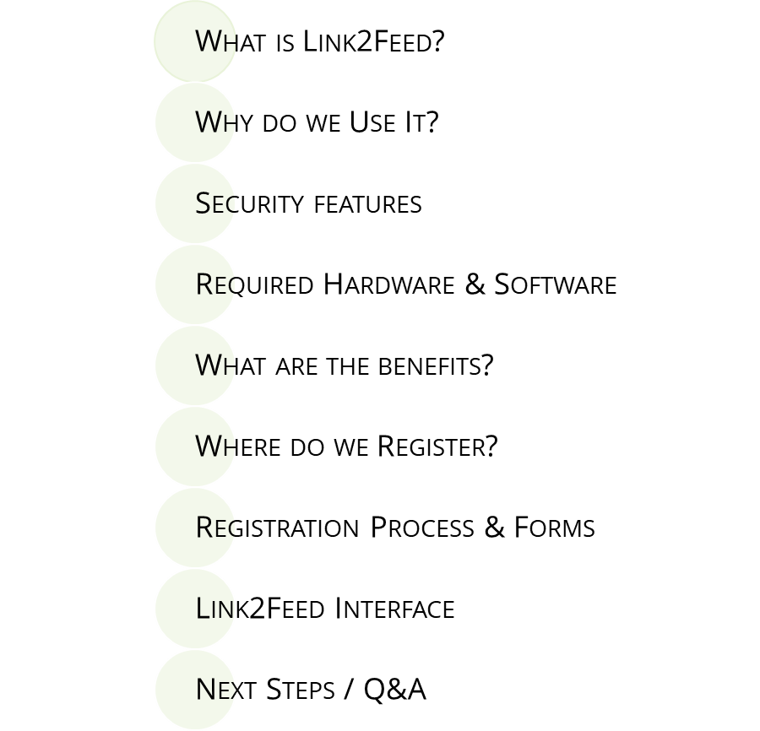

Link2Feed Agency Agenda

Slide 3

What is Link2Feed & Why Use it?

Slide 4

So…What is Link2Feed?

Slide 5
Link2Feed Is An Answer
Link2Feed (L2F) is a holistic client management system built especially for hunger relief organizations.
Link2Feed allows us to answer:
Who are our clients?
What are the needs of our clients?
Where are they located?
Allowing us to understand true client needs and close food gaps.

Slide 6
What Is The Purpose Of Using Link2Feed?
Used to collect, manage, and report service data
Generate custom reports.
Provide real-time information.
100% Online*
Gathers all required information that is needed for compliance as a network
Maintain safe and secure client information.
Track all programs across AFFB’s entire network
Notes:
Reports – apply for grants
Link2Feed tracks client Visits, generates statistical reports, and Analysis trends --To estimate #household, food..
increases understanding of food insecurity in our communities. This paperless alternative for data tracking enables our partners to more efficiently and effectively support their clients through a simple and easy to learn software
AAFB- 61 agencies

Slide 7
Security Features

Slide 8
Link2Feed Security Features
256-Bit Encryption (same level as online banking)
Reports have no identifiable information
Automatic timeout feature that logs users out after a period of inactivity
Customized user accounts to provide only relevant information for their job function
AFFB and L2F are extremely committed to client dignity and security.

Slide 9


Hardware & Software Requirements
Hardware Requirements
Other Info
Memory (RAM): 512 MB
Hard Drive Space: 500 MB
Internet Access: via Ethernet, WiFi, Gobi (4G/4G LTE), Mobile Broadband (4G/4G LTE)
JavaScript must be enabled
Cookies must be enabled
SSL must be enabled
Some reports require Flash (table tools)
  Chrome contains Flash by default
  Firefox and Safari require Flash to be installed
Software Requirements
Supported Operating Systems
Web Browser – No Internet Explorer or Edge!
  Google Chrome (up to date)
  Mozilla Firefox (up to date)
  Safari 7+ (up to date / OS X only)
Windows (7 or Higher)
Mac OS X (10.9 or Higher)
Notes:
Very flexible (phone, tablet) but you don’t have to bring your own equipment unless you want to – describe the box and everything it has in it (clipboards, paperwork organized, computers, cheat sheets, pens, stapler necklaces, hotspot)
-note no access through Microsoft-based browsers
-Internet Explorer/Edge does not have high security

Slide 10
What are the Benefits?

Slide 11
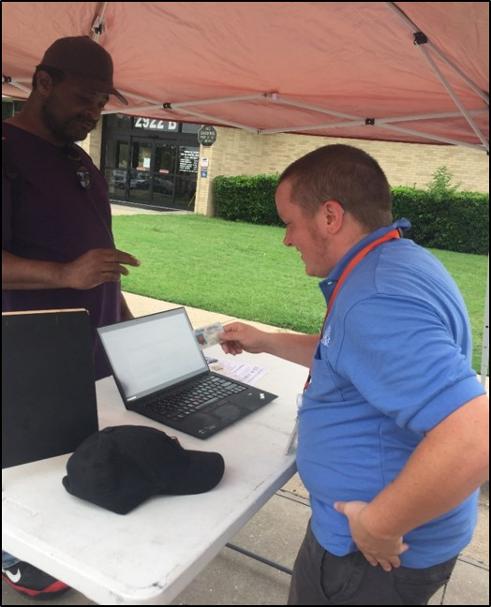
Benefits to our Neighbors
Increased Resources
Fast & Easy Check-In For Future Services
One-time Registration Across All Network Providers
Confidential
Link2Feed’s software helps All Faiths Food Bank’s network understand who is using their services and how to help them

Slide 12
Benefits to our AFFB Network
EASY INTAKE
Intuitive Step-By-Step Intake Process Easy For Those With Limited Computer Experience
*PAPERLESS PROCESS
Eliminates The Need For Hardcopy Client Files
AUTOMATED COMPLIANCE
TEFAP Requirements Including Electronic Signature, Eligibility, & Reporting Directly In The Software
GRAPHIC REPORTING
Generate Custom Reports Saving Hours Of Manual Tabulation & Making Analysis Easy
MULTI-PROGRAM TRACKING
Track All Programs Across AFFB’s Entire Network For Accurate Unduplicated Reporting
IMPROVED EFFICIENCY
Increase Our Network’s Efficiency & Communication
Notes:
- Very straightforward to use, haven’t met anyone yet who couldn’t do it regardless of computer literacy
Pink points not currently true (faster to do on paper, still collect TEFAP on paper)
Reporting mostly not your problem but it’s cool
Multi-program tracking, did not use to have access to unduplicated count! Major reason why we moved to this system although we are not using it to limit client access
Just generally more efficient to have everyone using the same system

Slide 13
Where Do
Neighbors Register?

Slide 14




Different Types of Pantries
Child & Family Pantries
Agency Pantries
Mobile Pantries*
All Non –TEFAP
Via Choice / Walk Up / Drive Thru
In Schools or Child Centered Organizations
In a Variety of Organizations
TEFAP
The Emergency Food Assistance Program
Phone* Calls
TEFAP Still Needs Signing
Via OfficePhones
TEFAP or Non-TEFAP Sites
Via Choice / Walk Up / Drive Thru
Mobile Pantries
Mobile Farm Markets
(Produce only)
In a Variety of Locations
Via Drive Thru*
(With Protein,Dry Goods, & Produce)
TEFAP Mobiles
Non – TEFAP
(USDA Subsidized Products: Protein, Dry Goods, & Produce)
Notes:
Total pantries 88 – running by agencies and running by AFFB
Running by AFFB -Mobile Pantries 27
Farm markets 4 (9)?
Non TEFAP 4
School Pantries 11
TEFAP Pantries 18

Slide 15
The
Process
& Forms

Slide 16
Always Collect Client Consent
When conducting intake with your client you must collect verbal consent to record their information. This is a great opportunity to tell them why we’re collecting data!
Intake Person: Hi! I’d like to get some information from you to add to our Link2Feed Database so the next time you come in your visit will be faster. Would that be OK?
Client: Why?
Intake Person: All Faiths Food Bank is collecting household information to improve our programs and services. This one-time registration will allow you to check-in at future visits using just Client ID or DOB. We will ensure that all your personal information will remain confidential and will not be shared outside of the food bank network.

Slide 17
What If A Client Doesn’t Want Their
Information In Link2Feed?
Non-TEFAP Sites
Full Refusal = Anonymous Visit
Minimum Required: Name, DOB, Address (Basic Registration)
Optional Information: Clients can choose not to answer other questions.
"Didn't Ask," "Don't Know," "Prefer Not To Answer" Options Available ("Didn't Ask": Prompts unanswered questions on the next visit)
TEFAP Sites - Qualified TEFAP Form Still Required
Anonymous Visits: Last Resort (Only Household Size Recorded)
Notes:
Change the undisclosed

Slide 18
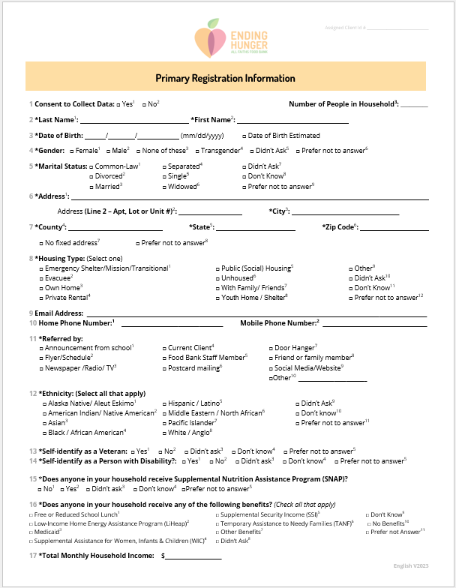
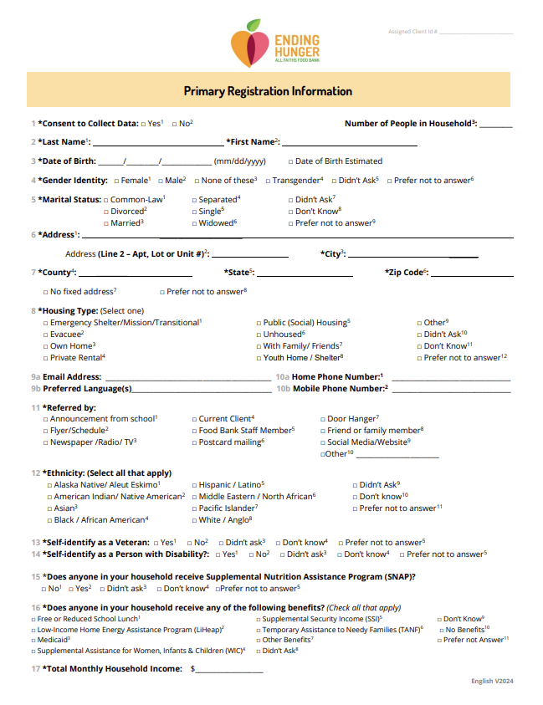
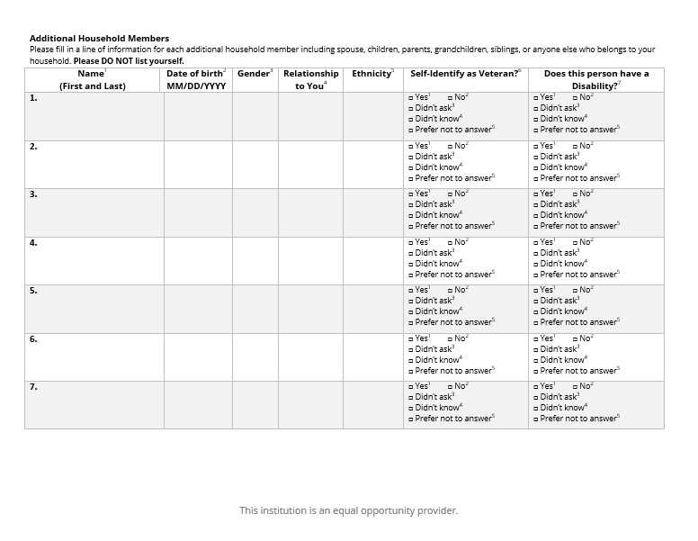
Intake Form in English, Spanish, Portuguese, Creole, Russian,
Ukrainian & Polish

Slide 19
TEFAP Qualifications
USDA Audits AFFB Annually
FLORIDA RESIDENCY
Social Service Benefit(s)
And/or
Qualified
Income
TEFAP
Eligible
Neighbor
Notes:
Total pantries 88 – running by agencies and running by AFFB
Running by AFFB -Mobile Pantries 27
Farm markets 4 (9)?
Non TEFAP 4
School Pantries 11
TEFAP Pantries 18
The Emergency Food Assistance Program (TEFAP) is a federal program that helps supplement the diets of low-income Americans, including elderly people, by providing them with emergency food assistance at no cost. Through TEFAP, the U.S. Department of Agriculture (USDA) purchases a variety of nutritious, high-quality USDA Foods, and makes those foods available to state distributing agencies.
Households may be eligible for TEFAP Foods for home consumption by self-declaration if:
Total household income is at or below 130 percent of the current poverty level for the number of persons in the household, or
A household must only receive TEFAP Foods within their county of residence.
The household currently receives assistance under the following programs:
Supplemental Nutrition Assistance Program (SNAP)
Temporary Assistance for Needy Families (TANF)
Supplemental Security Income (SSI)
Medicaid

Slide 20
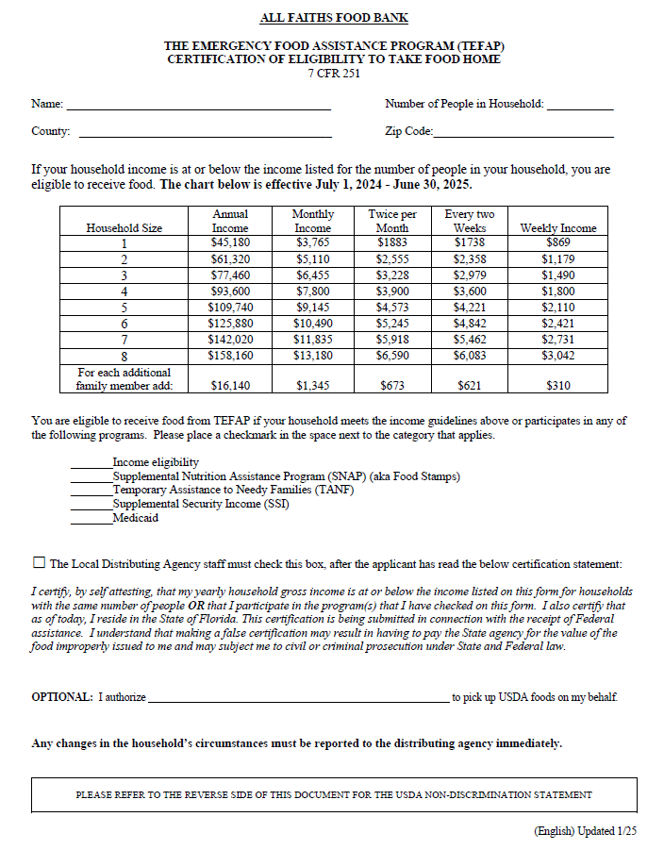
TEFAP Form
Name
# in House
FL County
Florida Residents Only
Need Social Services and/or Income Eligibility
Filled out by Neighbor
Zip Code
Qualifiers: Benefits and/or Income
We check this box
to verify the neighbor completed and read the entire form.
Proxy Name
(Someone outside house)
Notes:
Still waiting on all the needed languages before we can distribute.
What is declared by selecting the box:
The Local Distributing Agency staff must check this box, after the applicant has read the below certifications statement:
I certify, by self attesting, that my yearly household gross income is at or below the income listed on this form for households with the same number of people OR that I participate in the program(s) that I have checked on this form. I also certify that as of today, I reside in the State of Florida. This certification is being submitted in connection with the receipt of Federal assistance. I understand that making a false certification may result in having to pay the State agency for the value of the food improperly issued to me and may subject me to civil or criminal prosecution under State and Federal law.

Slide 21

The
Link 2 Feed Interface

Slide 22

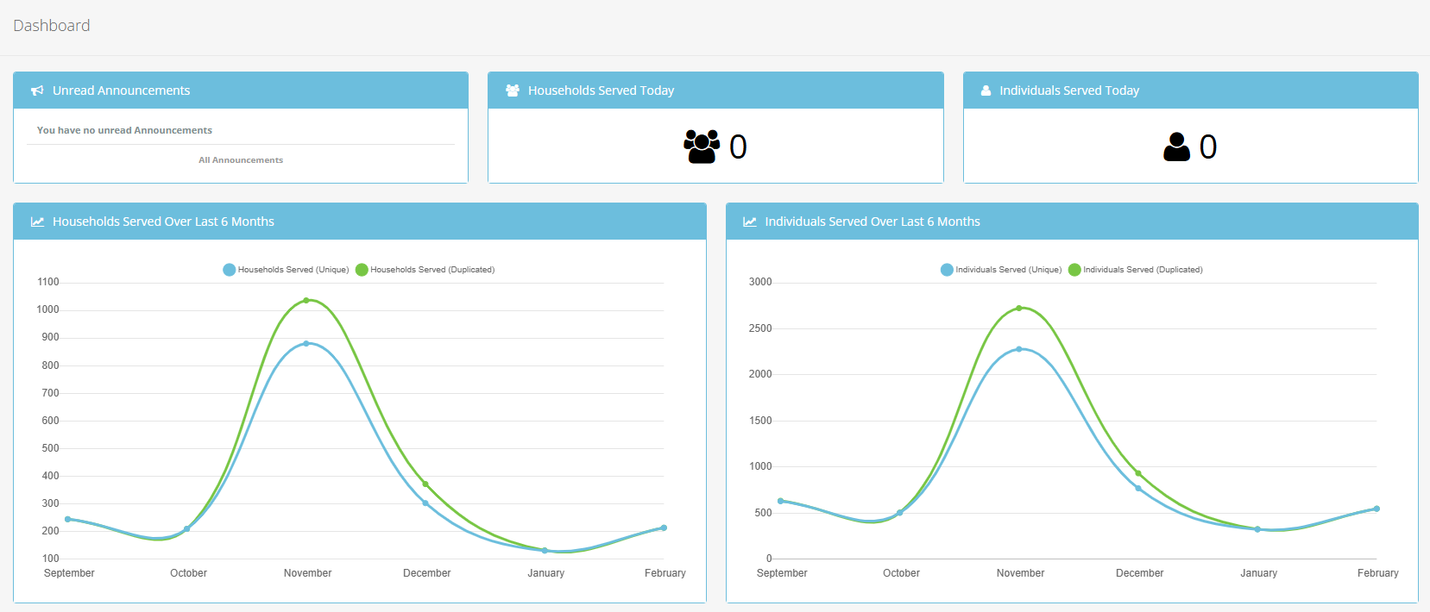

L2F User Roles
GENERAL USER – Creates new profiles and enters neighbor visits.
REPORTER –Access to the report system. The user can request a Dashboard Report and is assigned Agency, Interactive, Statistics, & Time Series which they reports they can run. (Other reports available upon request)
MANAGER–
- Access limited agency settings.
- Create, edit, and deactivate users within assigned organizations.
Responsibilities: - Create, edit, and delete visits (requires Data Entry role):
- Must log into the organization where visits were recorded to edit or delete them.
- Access to Client Notes Review.
Additional Features: - Ability to promote a household member.
- Ability to mark a client’s profile as deceased.
Notes:
Statistics provides numbers and gives visuals (pie charts, bar charts etc) for all info we collect
Heat map helps determine where to place new sites
Interactive lets you compare different types of info eg if you wanted to know out of all our clients how many are veterans, and out of veterans how many are homeless, and out of homeless veterans how many receive disability etc…)

Slide 23
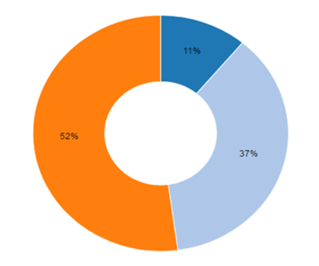
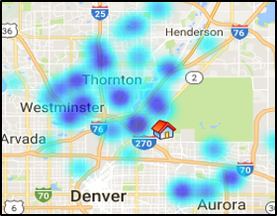
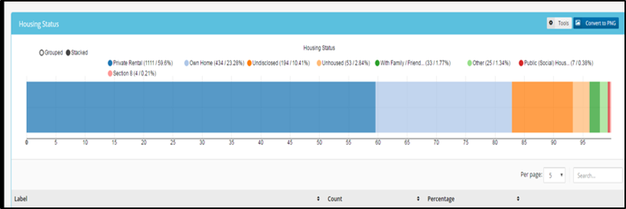
Reporting Features in Network
STATISTICS REPORT – Used to complete monthly reports. Provides an aggregate overview of various metrics, configurable at run-time
HEAT MAP REPORT – A visual distribution of clients who have visited in the report period.
INTERACTIVE HOUSEHOLD REPORT – Allows pivoting of data with the click of a mouse!
Notes:
Statistics provides numbers and gives visuals (pie charts, bar charts etc) for all info we collect
Heat map helps determine where to place new sites
Interactive lets you compare different types of info eg if you wanted to know out of all our clients how many are veterans, and out of veterans how many are homeless, and out of homeless veterans how many receive disability etc…)

Slide 24
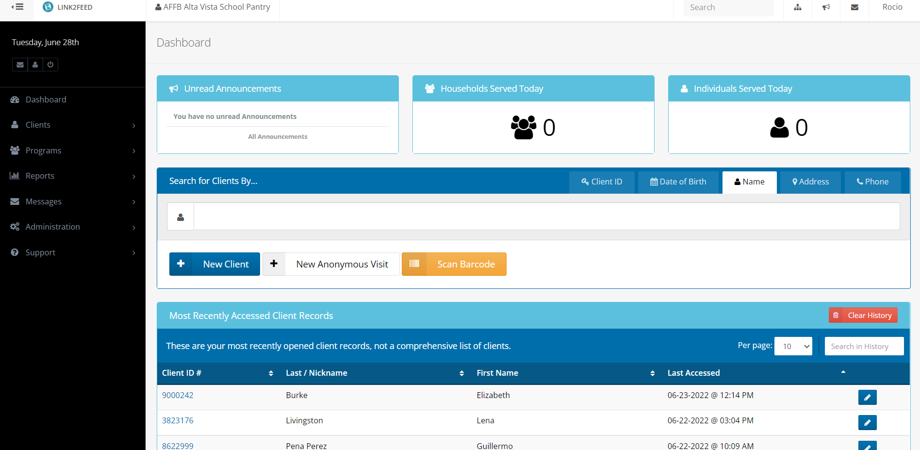
Link2Feed Dashboard

Slide 25
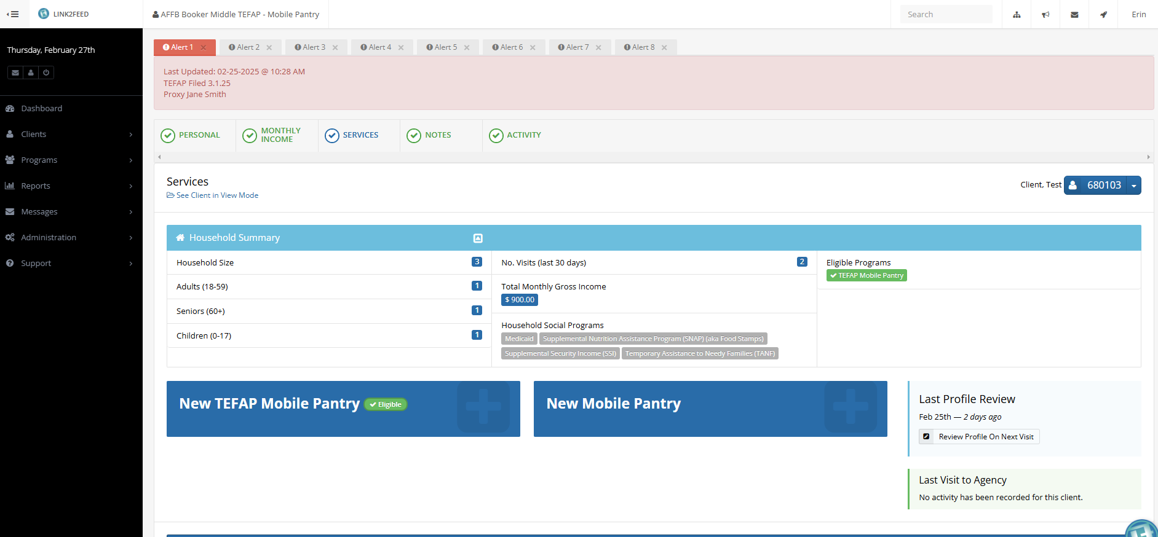
Services Page (Default)
Where the Pantry Visit is recorded
the Alert Notes tEFAP Dates & Proxies
The Tabs for the Different Profile Pages (Default is Services)
Client Name and ID#
This Bar is the Registration Button: Click here to Register This Pantry Visit
This Bar will Vary based on Type of Pantry you’re logged into
i.e., Mobile Farm Market, Tefap Mobile, Mobile Pantry, School Pantry ,Partner

Slide 26
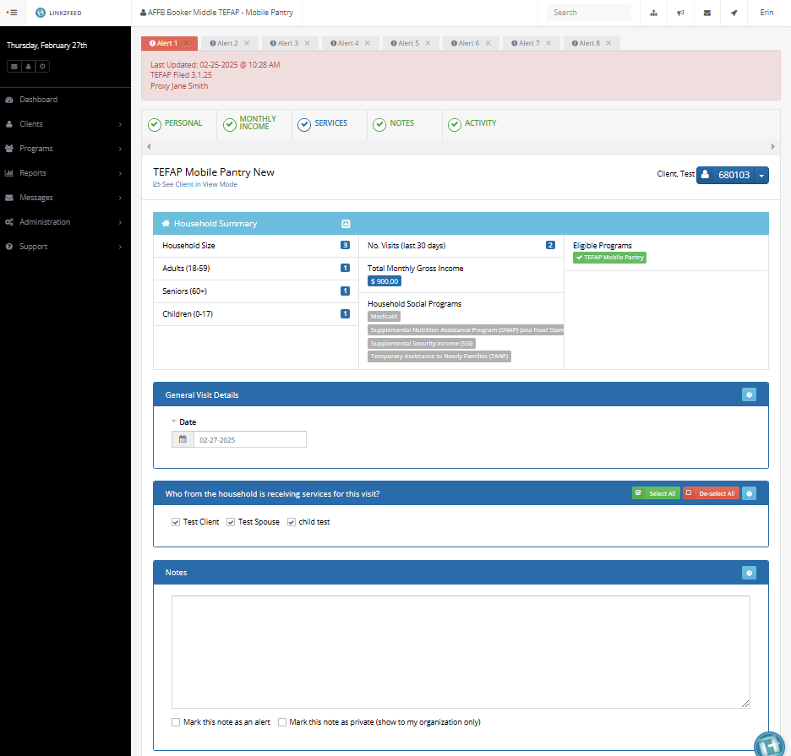
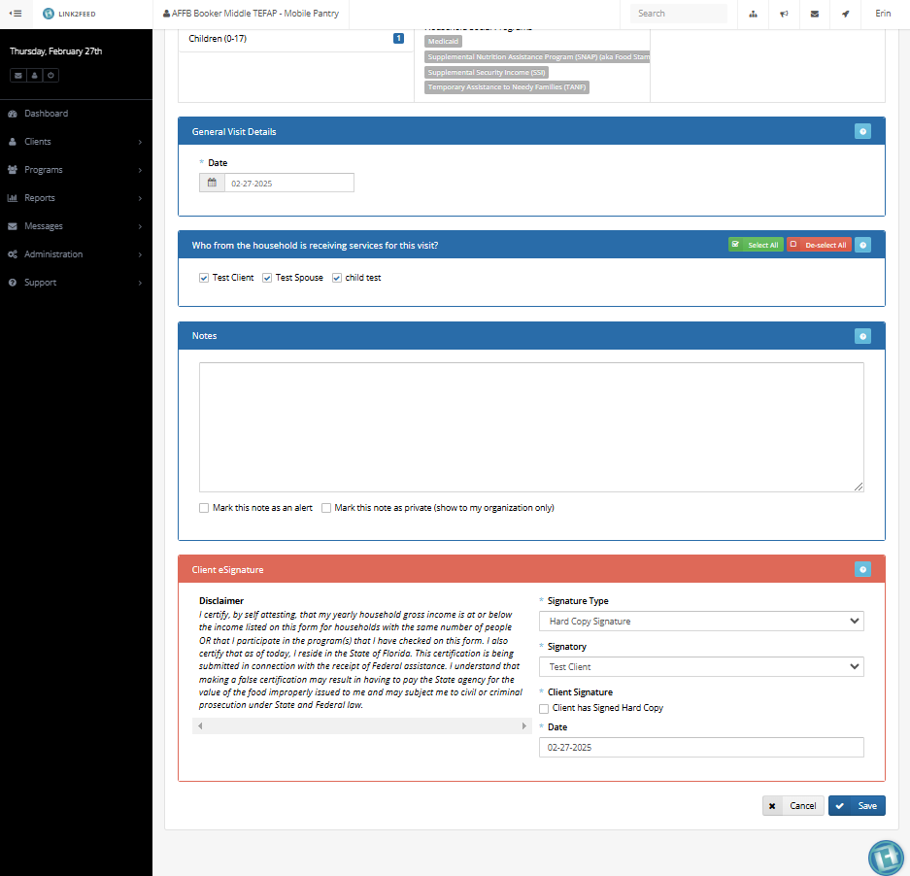
New TEFAP Services Entry
Top of TEFAP Service Registration Page
Bottom of same Page
Check this information for Eligibility
Scroll All the Way Down
Green means
Eligible
Scroll All the Way Down
Select
Signature TYPe
Hard Copy
Select Box Has Signed Hard Copy
Select Save to Register the Visit

Slide 27
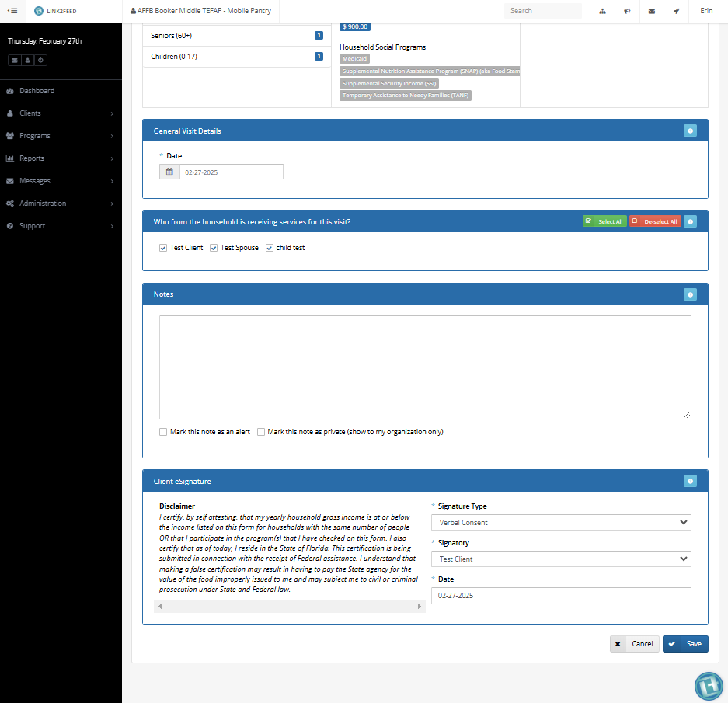
Already Filed TEFAP Services Entry
Top of TEFAP Service Registration Page
Bottom of same Page
Check this information for Eligibility
Scroll All the Way Down
Green means
Eligible
Scroll All the Way Down
Signature Type
Leave as
Verbal Consent
Select Save to Register the Visit

Slide 28
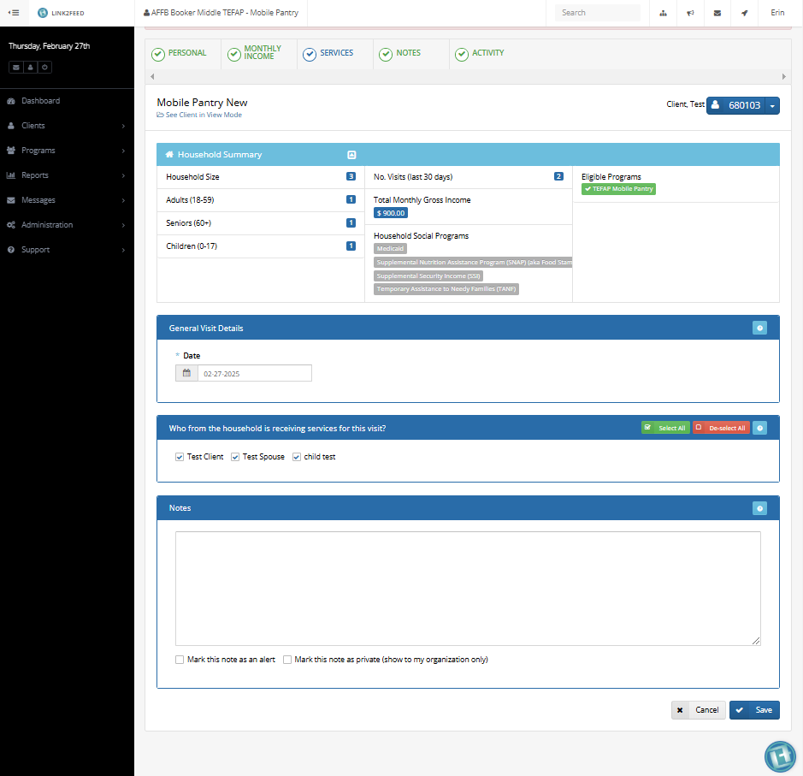
Non-TEFAP Services Entry
Select Save to Register the Visit

Slide 29
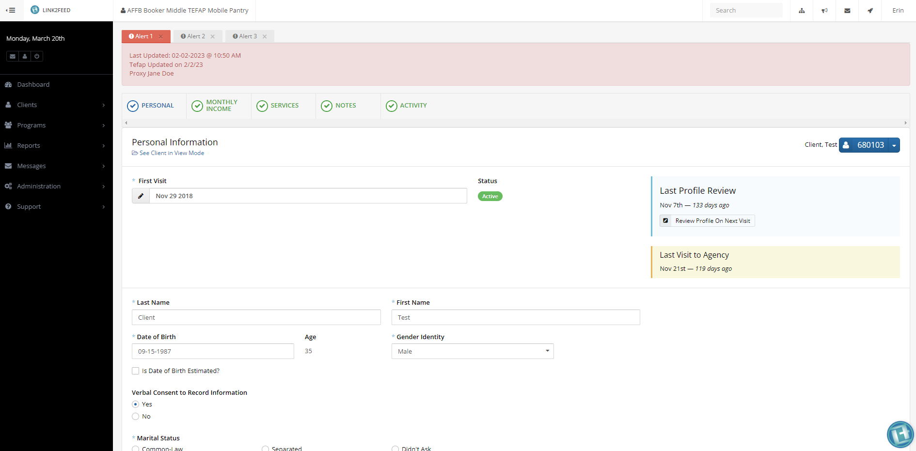
Client Personal Page
The Same Alert Notes Show at the Top of each Page
The Blue Tab is the page You’re Viewing
Same Client Name and ID#
Be Sure to Complete all * Fields & scroll Down

Slide 30
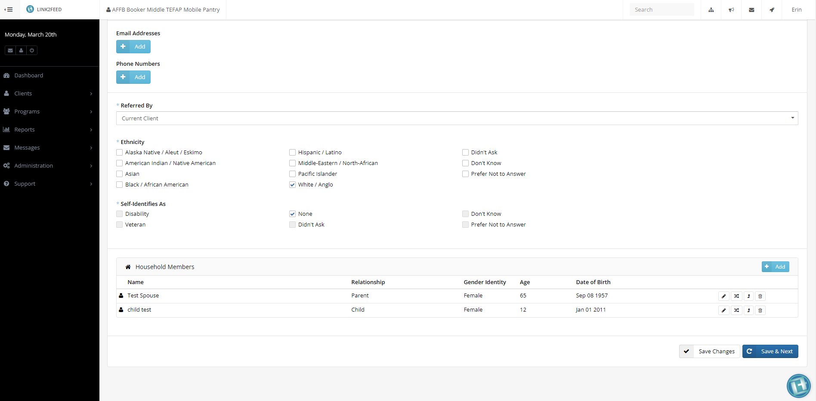
Client Personal Page Continued
(Bottom) Households
To Remove a household Member (they’re still in the system, just not this household)
To Edit Household Member
What we use most
To Add New MemBer
Check to Make Sure Household Members are All included and Correct
After Entering/Verifying all Data
Tap on Save & Next to Save all fields and move to Monthly Income Page

Slide 31
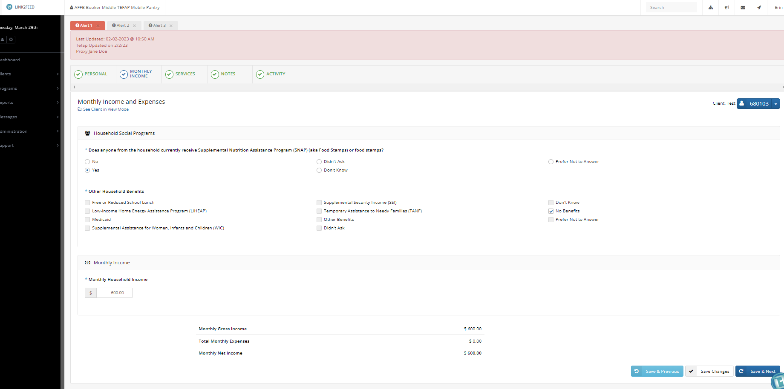
Client Monthly Services Page where you’re sent after Save & Next in Personal Page
Monthly Income Tab is Blue
Fill out all Applicable Benefits Fields & the Monthly Household Income
Click Save
& Next

Slide 32
Client Services Page where you’re sent after Save & Next in Monthly Income
After Save & Next in Monthly Income, System moves to Service Page
If you need to update the Notes,
Click on this Notes Tab
If you haven’t Registered the Visit Yet, Select This Bar & follow Instructions As stated before

Slide 33
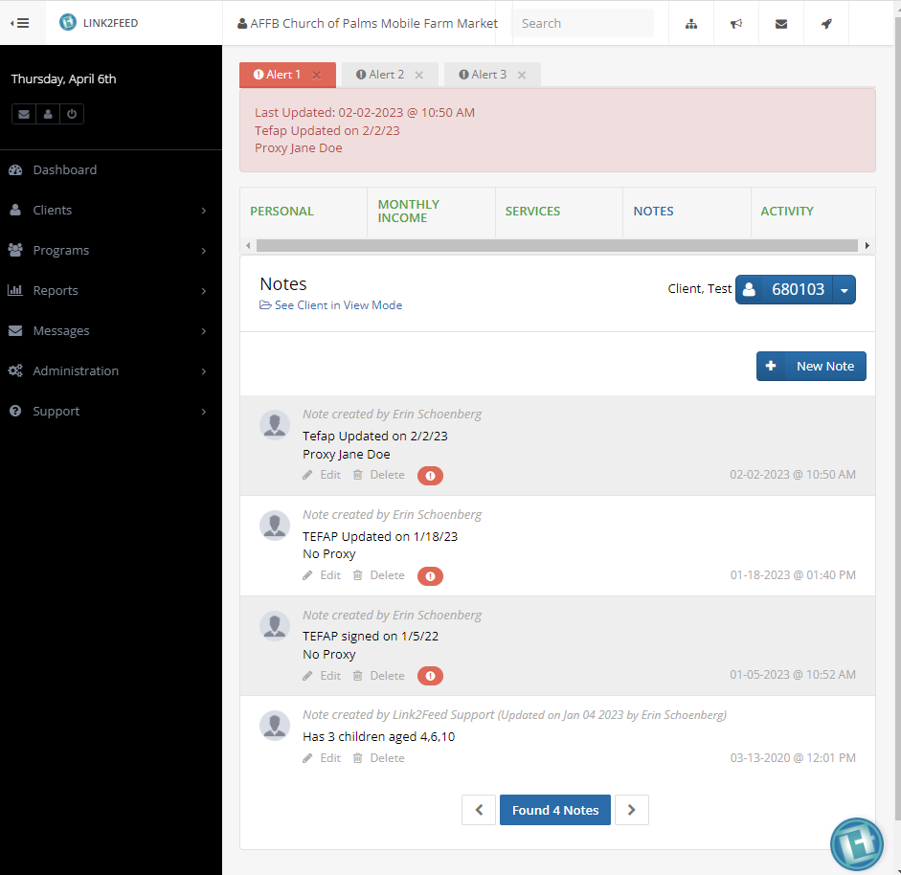
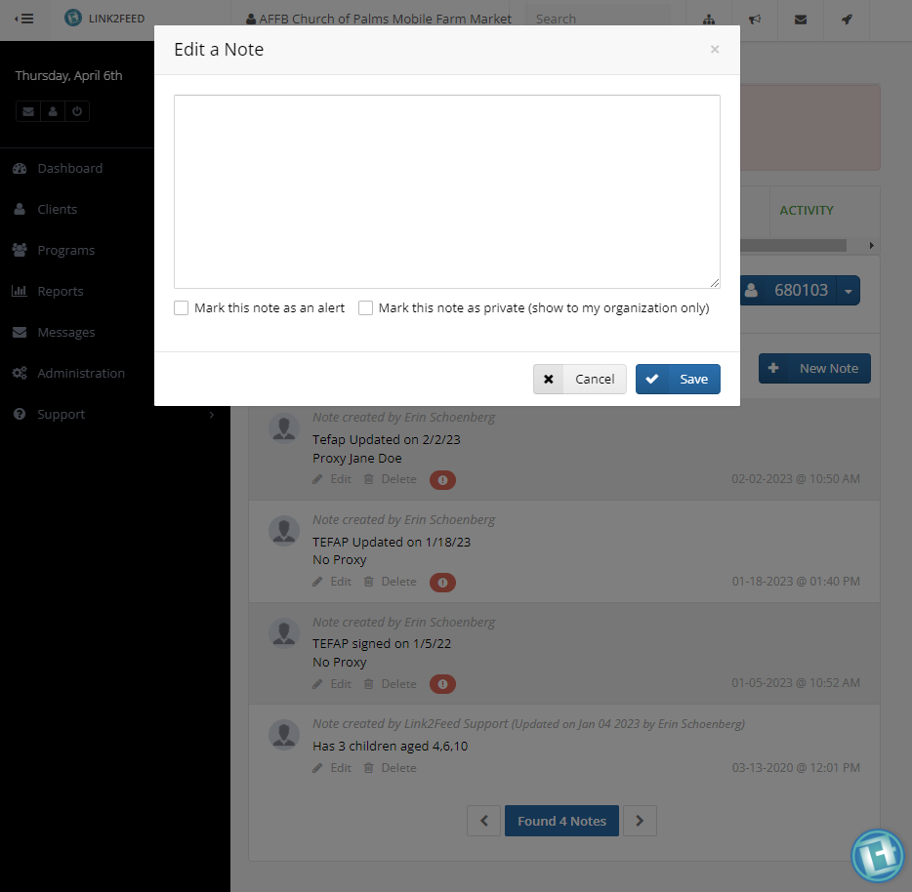
Client Notes page
You must Click on Notes Tab to go to this page
Enter in New Notes here
Notes Tab is in Blue
Check this Box to Set Alert
Click Here Create new Note
Click Save

Slide 34
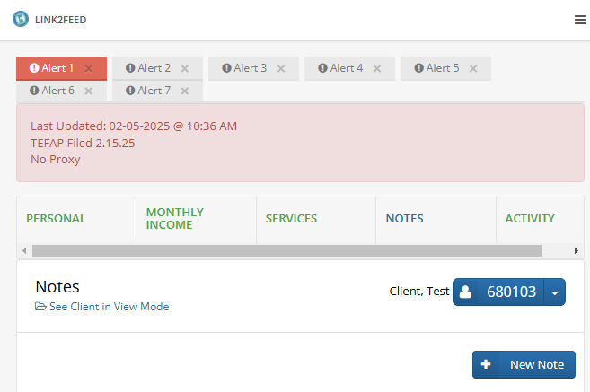
New L2F
Note
Notes:
New eligibility guidelines are more inclusive and easier to maintain

Slide 35
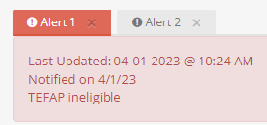
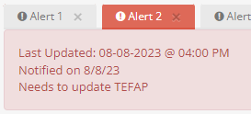
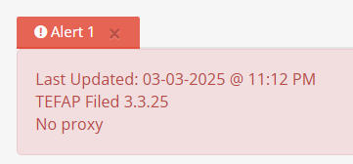
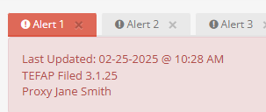
Notes on Notes…
L2F Notes Needed for Accountability & Compliance
  TEFAP Ineligible: Notified on “Date”, TEFAP Ineligible
  TEFAP needs Updating: Notified on “Date”, needs to Update TEFAP
  4. TEFAP Filed: TEFAP Filed on “Date”, Proxy “Full Name” or No Proxy

Slide 36
Next Steps
Questions & Answers

Slide 37
Next steps
Sign Memorandum of Understanding Form
Civil Rights Training
  Click Here to Register
Registration Resources in Agency Portal
  https://allfaithsfoodbank.org/partner-agency-forms/

Slide 38
Any Questions ?
Erin EverGreen
Client Registration Coordinator
(941) 379-6333 EXT 143
EEverGreen@AllFaithsFoodBank.org
Office Hours: Most Tuesdays & Thursdays 12pm - 1pm
Programs Assistant/Registration
(941) 379-6333 EXT 176
Office Hours: Most Mon, Wed, & Fri 12pm – 1pm

