Slide 1

TEFAP Process & NOtes

Slide 2
TEFAP Qualifications
USDA Audits AFFB Annually
FLORIDA RESIDENCY
Social Service Benefit(s)
And/or
Qualified
Income
TEFAP
Eligible
Neighbor
Notes:
Total pantries 88 – running by agencies and running by AFFB
Running by AFFB -Mobile Pantries 27
Farm markets 4 (9)?
Non TEFAP 4
School Pantries 11
TEFAP Pantries 18
The Emergency Food Assistance Program (TEFAP) is a federal program that helps supplement the diets of low-income Americans, including elderly people, by providing them with emergency food assistance at no cost. Through TEFAP, the U.S. Department of Agriculture (USDA) purchases a variety of nutritious, high-quality USDA Foods, and makes those foods available to state distributing agencies.
Households may be eligible for TEFAP Foods for home consumption by self-declaration if:
Total household income is at or below 130 percent of the current poverty level for the number of persons in the household, or
A household must only receive TEFAP Foods within their county of residence.
The household currently receives assistance under the following programs:
Supplemental Nutrition Assistance Program (SNAP)
Temporary Assistance for Needy Families (TANF)
Supplemental Security Income (SSI)
Medicaid

Slide 3
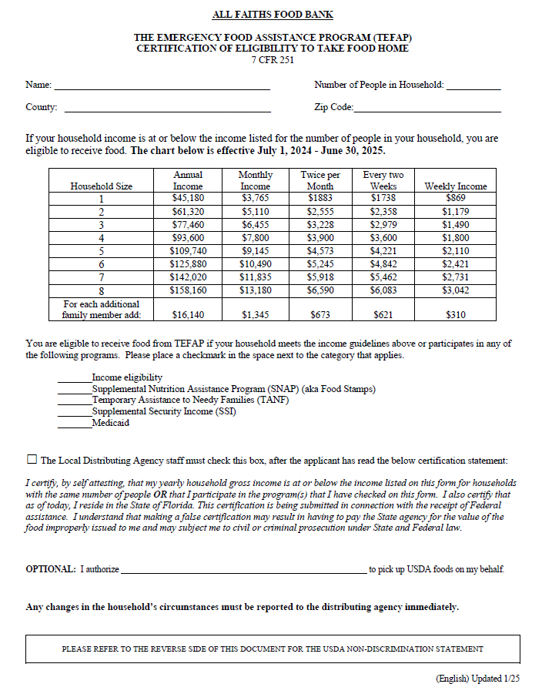
TEFAP Form
Name
# in House
FL County
Florida Residents Only
Need Social Services and/or Income Eligibility
Filled out by Neighbor
Zip Code
Qualifiers: Benefits and/or Income
We check this box
to verify the neighbor completed and read the entire form.
Proxy Name
(Someone outside house)
Notes:
Still waiting on all the needed languages before we can distribute.
What is declared by selecting the box:
The Local Distributing Agency staff must check this box, after the applicant has read the below certifications statement:
I certify, by self attesting, that my yearly household gross income is at or below the income listed on this form for households with the same number of people OR that I participate in the program(s) that I have checked on this form. I also certify that as of today, I reside in the State of Florida. This certification is being submitted in connection with the receipt of Federal assistance. I understand that making a false certification may result in having to pay the State agency for the value of the food improperly issued to me and may subject me to civil or criminal prosecution under State and Federal law.

Slide 4

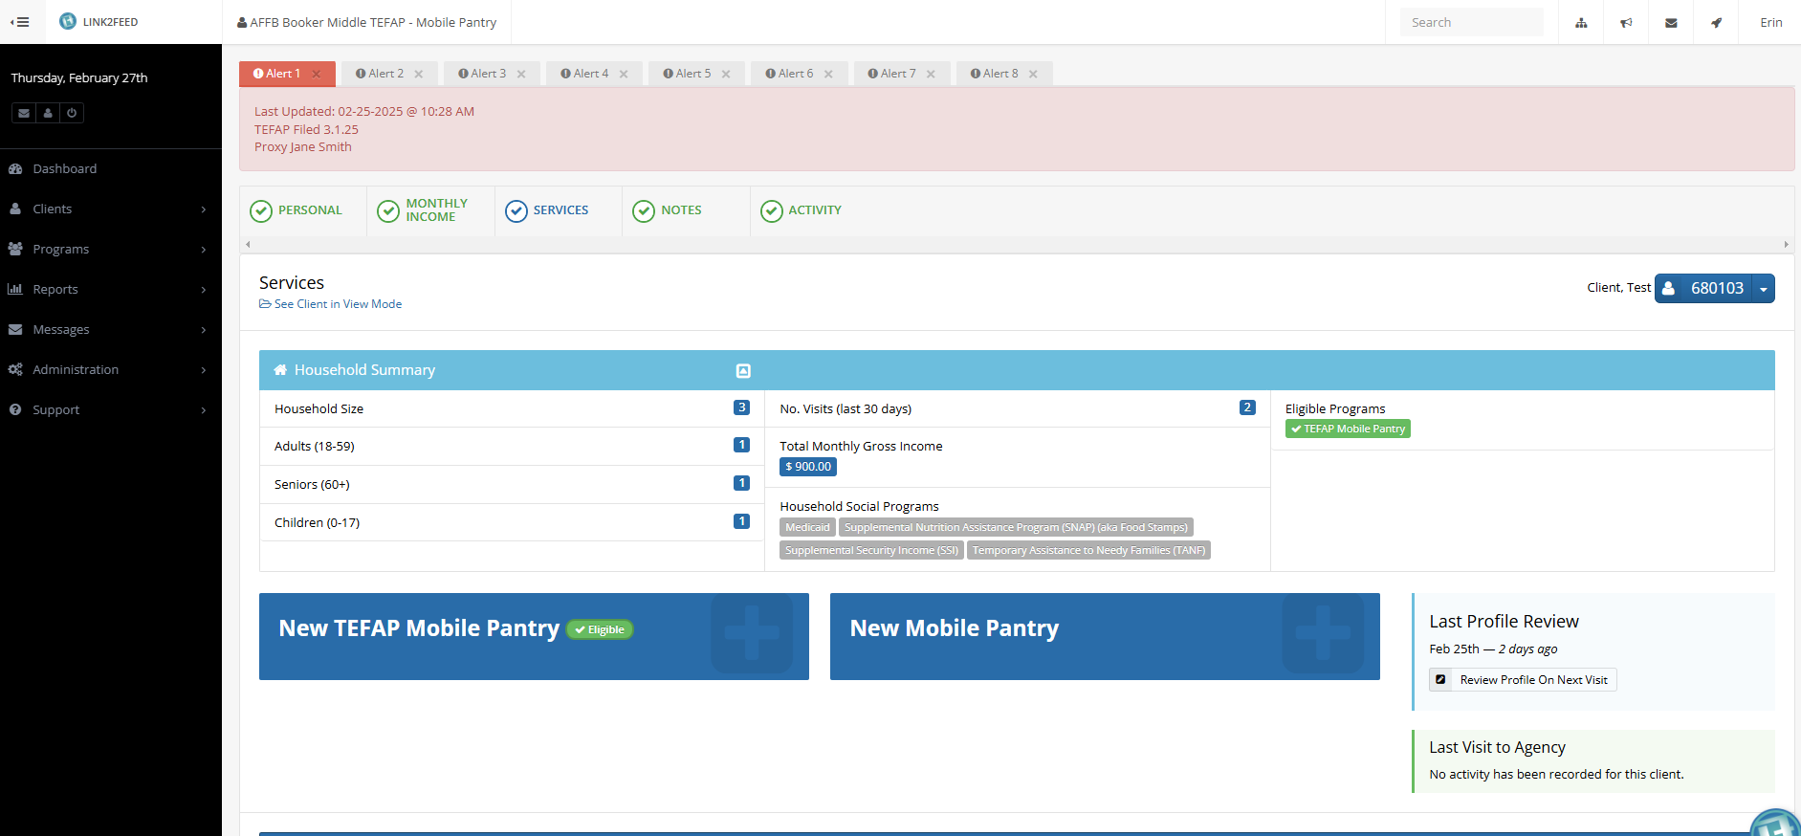
L2F Services Page Where the Pantry Visit is recorded
the Alert Notes tEFAP Dates & Proxies
The Tabs for the Different Profile Pages (Default is Services)
Client Name and ID#
This Bar is the Registration Button: Click here to Register This Pantry Visit
This Bar will Vary based on Type of Pantry you’re logged into
SELECT TEFAP FOR USDA VISIT

Slide 5
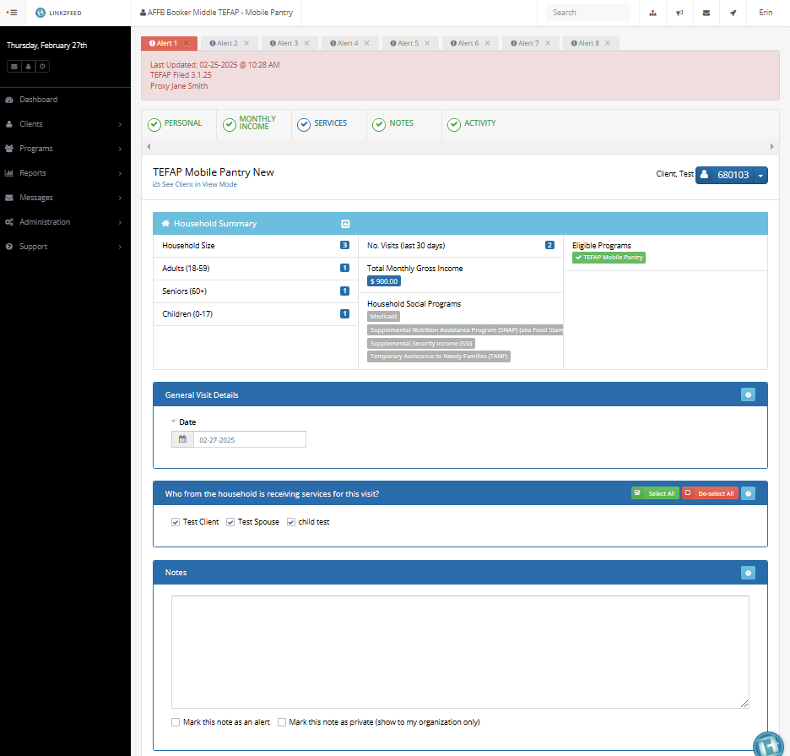
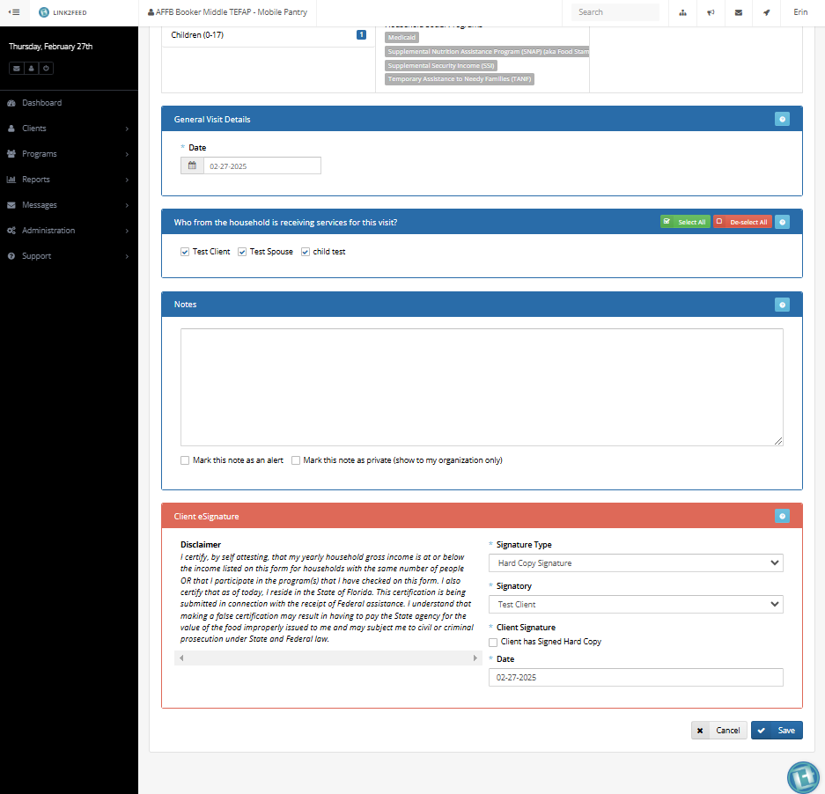
New TEFAP Services Entry
Top of TEFAP Service Registration Page
Bottom of same Page
Check this information for Eligibility
Scroll All the Way Down
Green means
Eligible
Scroll All the Way Down
Select
Signature TYPe
Hard Copy
Select Box Has Signed Hard Copy
Select Save to Register the Visit

Slide 6
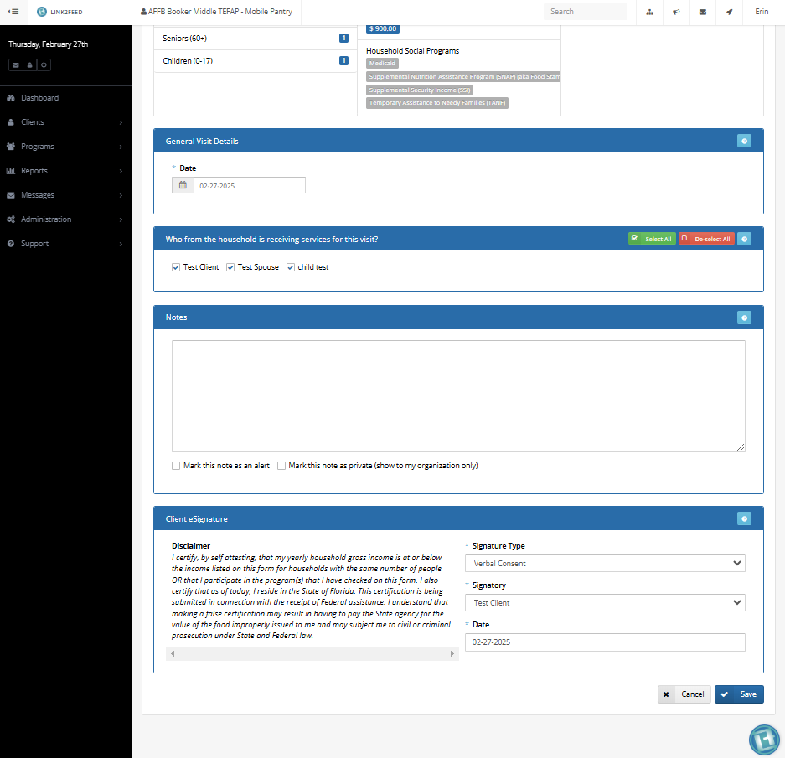
Already Filed TEFAP Services Entry
Top of TEFAP Service Registration Page
Bottom of same Page
Check this information for Eligibility
Scroll All the Way Down
Green means
Eligible
Scroll All the Way Down
Signature Type
Leave as
Verbal Consent
Select Save to Register the Visit

Slide 7
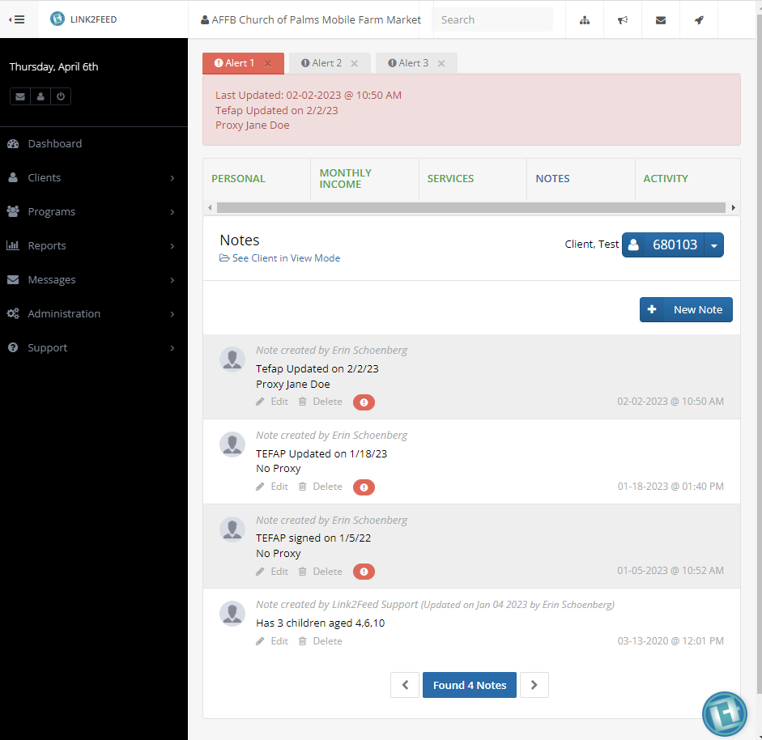
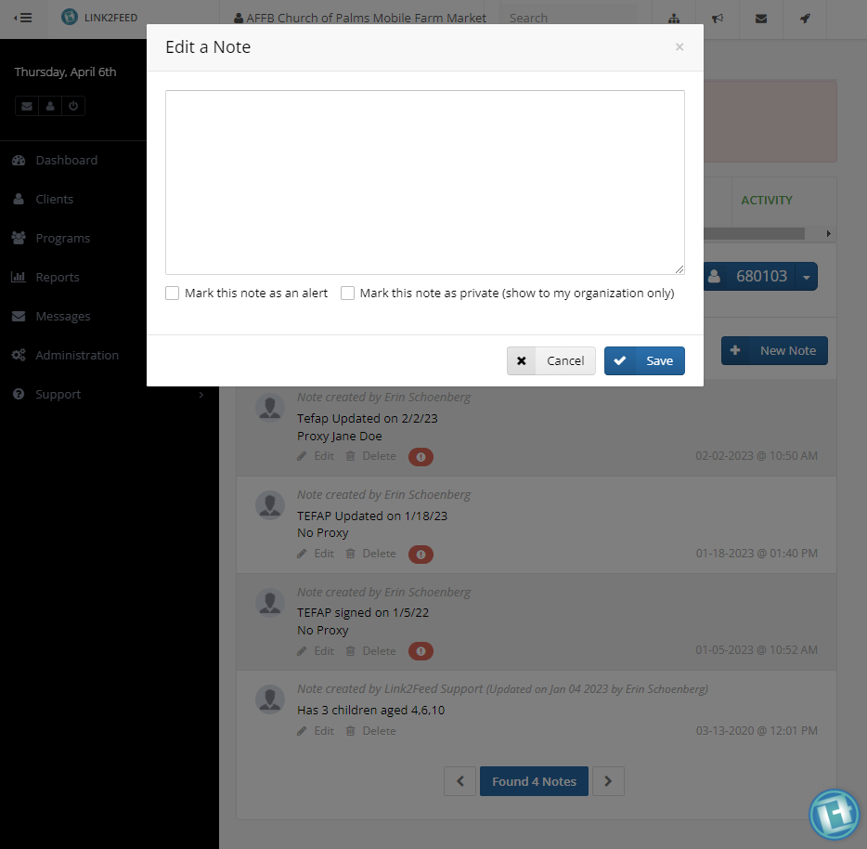
Notes page You must click on the Notes Tab to go to this page
Enter in New Notes here
Notes Tab is in Blue
Check this Box to Set Alert
Click Here Create new Note
Click Save

Slide 8
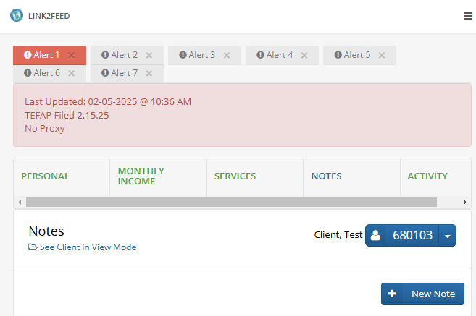
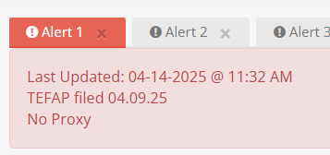
Standard New L2F
Note
Notes:
New eligibility guidelines are more inclusive and easier to maintain

Slide 9
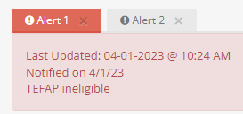
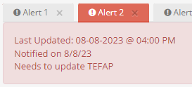
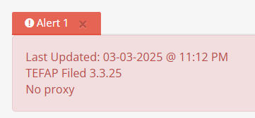
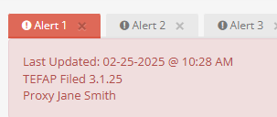
Correct Notes
Consistent L2F Notes Needed for Accountability & Compliance
  TEFAP Ineligible: Notified on “Date”, TEFAP Ineligible
  TEFAP needs Updating: Notified on “Date”, needs to Update TEFAP
  4. TEFAP Filed: TEFAP Filed on “Date”, Proxy “Full Name” or No Proxy

