Slide 1


Slide 2

CIVIL RIGHTS TRAINING
FOR TEFAP & CSFP SUBRECIPIENTS
Florida Department of Agriculture and Consumer Services
This institution is an equal opportunity provider.

Slide 3

AGENDA
•
•
•
Collection and Use of Client Data Effective Public Notification Systems
Requirements for Language Assistance
Reasonable Accommodation of Persons with Disabilities
Complaint Procedures Compliance Reviews Resolution of Non-Compliance Customer Service
Conflict Resolution
•
•
•
•
•
•
Notes:
Today we will go over all the areas required by USDA to complete annual Civil Rights training. The goals of this training are to learn:
How the federal government defines discrimination in TEFAP;
What racial and ethnic data is required to be collected;
The requirements for communicating with clients and potential clients who do not speak English;
How to ensure our facilities and outreach tools do not discriminate against persons with disabilities;
How to notify clients and potential clients of our programs and their civil rights as it relates to them;
How to identify and process a civil rights complaint;
The process for monitoring agencies for civil rights compliance;
What happens when an agency is not in compliance;
And effective customer service and conflict resolution techniques.

Slide 4
WHY CIVIL RIGHTS TRAINING?
DOCUMENT
TRAINING
•
Training is required so that individuals involved in all levels of administration of programs that receive Federal financial assistance understand Federal laws, regulations, instructions, policies and other guidance.
•
Subrecipients are responsible for training their Sub distributors and Local Agencies, including paid or volunteer staff who interact with participants or who handle participants’ records, on an annual basis.
•
New employees must be trained before participating in TEFAP/CSFP activities.
•
Volunteers must receive training appropriate to their roles and responsibilities.

Slide 5

WHAT IS DISCRIMINATION?
The act of distinguishing one person or group of persons from others, either intentionally, by neglect or by the effect of actions or lack of actions based on their protected classes.
Notes:
Discrimination happens when a person is treated differently than others for reasons outside of their control, such as their age, race, disability, etc. Sometimes discrimination happens on purpose- and sometimes it happens because organizations were not properly prepared to meet the needs of all program participants.

Slide 6

EXAMPLES OF TYPES OF DISCRIMINATION
Disparate treatment (Intentional)
Example: Religious
Disparate impact (Unintentional)
Example: Russian
Reprisal/Retaliation: (Intentional)
Example: Civil Rights Complaint
Notes:
Disparate Treatment (Intentional)
This is when a food bank intentionally treats someone differently based on a protected characteristic.
Example: A food bank manager tells a volunteer not to give food to a person because they are from a specific country, even though that person is eligible for assistance. The manager is intentionally discriminating based on national origin.
Disparate Impact (Unintentional)
This happens when a food bank has a neutral policy that unintentionally harms a protected group.
Example: A food bank requires all clients to show a driver's license to receive food. This rule might seem fair, but it could unintentionally create a barrier for elderly people, recent immigrants, or low-income individuals who are less likely to have a driver's license, disproportionately impacting these groups.
Reprisal/Retaliation (Intentional)
This is when a food bank punishes someone for speaking up about discrimination.
Example: A volunteer at the food bank complains to the director that a supervisor is making discriminatory remarks. In response, the supervisor intentionally removes the volunteer from the schedule and refuses to let them work, punishing them for reporting the issue.

Slide 7

PROTECTED CLASSES
Protected classes for TEFAP/CSFP:
•
•
•
•
•
•
Age Color Disability
National Origin Race
Sex
People are also protected from reprisal or retaliation for prior civil rights activity.
Notes:
TEFAP recipients are protected from being treated differently because of any of the following reasons – disability, national origin, age, race, color and sex. These are called the protected classes. If someone files a civil rights complaint, they are also protected from retaliation. Retaliation happens when they are treated differently because they filed a complaint.
Do you think this scenario could be discriminatory? A food pantry that distributes TEFAP foods is located on the second floor of a building that does not have an elevator. Is this discriminatory? Why or why not?
The answer is yes, it could be discriminatory against people with disabilities. The pantry should attempt to make their building handicap accessible. If that is not possible, some other options would be bringing distribution for USDA programs downstairs or providing home delivery service for people with disabilities.

Slide 8

NON-DISCRIMINATION STATEMENT
LONG VERSION
vs.
SHORT VERSION
Notes:
The “USDA Non-Discrimination Statement” must be included on all materials that mentions TEFAP or CSFP.
There is both a “long’ and “short’ version. If there is room on your document, please use the long version. It is ok to use the short version when you do not have room for the full version. However, client eligibility forms or any materials explaining client rights and responsibilities must have the long version.
Any public program material must have the non-discrimination statement printed on it. This includes handouts, signs, web sites, forms, etc.
Web sites must have the statement on the first page only. It is not required to be on each page of the site
The font size should not be any smaller than the rest of your text to ensure that participants can read it.

Slide 9
NONDISCRIMINATION STATEMENT
LONG VERSION
In accordance with federal civil rights law and U.S. Department of Agriculture (USDA) civil rights regulations and policies, this institution is prohibited from discriminating on the basis of race, color, national origin, sex, disability, age, or reprisal or retaliation for prior civil rights activity.
Program information may be made available in languages other than English. Persons with disabilities who require alternative means of communication to obtain program information (e.g., Braille, large print, audiotape, American Sign Language), should contact the responsible state or local agency that administers the program or USDA’s TARGET Center at (202) 720-2600 (voice and TTY) or contact USDA through the Federal Relay Service at (800) 877-8339.
To file a program discrimination complaint, a Complainant should complete a Form AD-3027, USDA Program Discrimination Complaint Form which can be obtained online at Program Discrimination Complaint Form English [ 409.6 kB] , Program Discrimination Complaint Form Spanish [389.3 kB] and,
Program Discrimination Complaint Form Haitian Creol [185.2 kB] e , from any USDA office, by calling (866) 632-9992, or by writing a letter addressed to USDA. The letter must contain the complainant’s name, address, telephone number, and a written description of the alleged discriminatory action in sufficient detail to inform the Assistant Secretary for Civil Rights (ASCR) about the nature and date of an alleged civil rights violation. The completed AD-3027 form or letter must be submitted to USDA by:
1. mail:
U.S. Department of Agriculture
Office of the Assistant Secretary for Civil Rights 1400 Independence Avenue, SW
Washington, D.C. 20250-9410; or
fax:
(833) 256-1665 or (202) 690-7442; or
email:
program.intake@usda.gov
This institution is an equal opportunity provider.

Slide 10
NONDISCRIMINATION STATEMENT
SHORT VERSION
“This institution is an equal opportunity provider.”
•
•
•
May be used in special circumstances only.
May not be used in place of long statement on recipients’ rights documents. Must be in font size no smaller than the font size used in rest of publication.

Slide 11

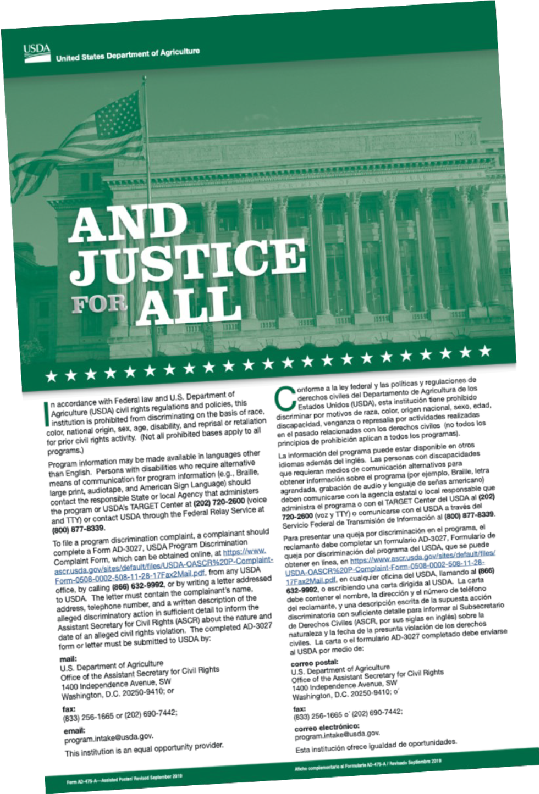
“AND JUSTICE FOR ALL”
Poster
•
•
This is the most current poster.
Post in a prominent location where recipients and applicants can see it. (This includes mobile distributions).
This poster serves as a trademark indicating the site provides USDA program without discrimination.
•

Slide 12
Question time!
Name the missing protected class.
Age, Color, Race, Sex, Disability and ?
Notes:
The answer is National Origin. That means people cannot be treated unfairly based on their ethnicity or accent or because they appear to be of a certain ethnic background.

Slide 13

DATA COLLECTION AND REPORTING

Slide 14
DATA COLLECTION AND REPORTING
Per FNS Instruction 113-1. Appendix C.
•
TEFAP is exempt from data collection requirements
•
The collection and reporting of recipients Ethnicity and Race for CSFP is required
Notes:
FNS Instruction 113-1 Appendix C
This document serves as the legal and regulatory foundation for our civil rights obligations. FNS Instruction 113-1 Appendix C is the official directive from the U.S. Department of Agriculture's Food and Nutrition Service. It provides the specific guidelines and requirements we must adhere to in our food distribution programs to ensure nondiscrimination and uphold the civil rights of all program participants.
In other words, This is the official rule from the USDA that tells us how to operate our food programs fairly and without discrimination. It's the reason we do things like collect data or put up posters. We have to follow these rules to get federal food.
TEFAP is exempt from data collection requirements
For TEFAP, we are not required to collect race and ethnicity information from clients, but we still must follow all other civil rights rules like checking eligibility and treating everyone fairly. This makes the process simpler and faster for sites that only distribute TEFAP food.

Slide 15
ETHNIC AND RACIAL DATA COLLECTION AND REPORTING
PURPOSE:
To determine how effectively Food and Nutrition Services (FNS) programs are reaching potentially eligible persons and participants, outreach and selection of locations for Administrative reviews.
Collect and Report annually for the month of April via FANS beginning in FY 24-25.
Due by May 31^{st.}
Collect at the Point of Application/Retain at the Service Delivery Area.
Limit data access to authorized personnel.
Notes:
DOES NOT APPLY TO AFFB Food Banks.

Slide 16
ETHNIC AND RACIAL DATA COLLECTION
Ethnicity & Race: Two separate categories as federally recognized by the Office of Management and Budget.
TWO-QUESTION FORMAT
Step 1 - Ethnicity Categories (Select one): Step 2 - Race Categories (Select one or more):
Hispanic or Latino – A person of Cuban, Mexican, Puerto Rican, South or Central American, or other Spanish culture or origin, regardless of race.
Not Hispanic or Latino
•
•
•
•
•
American Indian or Alaskan Native Asian
Black or African American
Native Hawaiian or Other Pacific Islander White
Notes:
DOES NOT APPLY TO AFFB Food Banks.

Slide 17

PUBLIC NOTIFICATION/OUTREACH METHODS
Reaching Prospective Clients
PRESS RELEASES – newspaper, TV station, online.
ADVERTISEMENTS – newspaper, social media, TV.
SIGNS – outside your facility, post serving times.
FLYERS – clinics, public assistance offices, schools, libraries, etc.
Provide information in different formats/languages.
Notes:
Public notification, or “outreach,” is required and agencies should do Public Notification of the program(s) at least annually.
A best practice is to do outreach continually through the year
Public notification informs potential clients of program availability, rights and responsibilities and complaint procedures
Try to reach underserved groups who may qualify using a variety of formats and languages – think about how to reach clients that may be disabled, limited in English proficiency and those who may have low education levels.

Slide 18
What would you do?
There is small Haitian community in your service area that may benefit from TEFAP. Your organization wants to create a flyer in Creole to distribute.
You have paid a translator, created and printed the flyer, but realized that you forgot the non-discrimination statement. Is it still okay to distribute the flyer?
Notes:
The answer is no. It is never okay to distribute program information without the non-discrimination statement.

Slide 19


LIMITED ENGLISH PROFICIENCY (LEP)
Persons with LEP are those do not speak English as their primary language and who have a limited ability to read, speak, write or understand English because of their national origin.
Responsibility to take reasonable steps to ensure “meaningful” access to their programs and activities.
•
Notes:
Agencies must take into consideration individuals who do not speak English as their primary language and who have a limited ability to read, speak, write, or understand English. If someone came to your agency and they only spoke Creole, would you be prepared to offer them service? If not, there is a potential for a “National Origin” civil rights complaint.
All agencies participating in TEFAP have the responsibility to take reasonable steps to ensure meaningful access to their programs and activities by persons with limited English proficiency (LEP).
Interpreters: Volunteers may be used as interpreters and must maintain participant confidentiality. Children should not be used as interpreters.

Slide 20
FACTORS FOR PROVIDING LANGUAGE ASSISTANCE
Level of service provided is based on the following factors. Shortage of resources does not eliminate requirement except for cases of extreme hardship.
Number or Proportion
Frequency
Importance
Resources
Notes:
Service must be provided, but there is some flexibility on methods used.
Factors to consider with addressing Limited English Proficiency are
Number or proportion of LEP persons served or encountered in the eligible population
Frequency with which LEP individuals come in contact with the program
Nature and importance of the program, activity, or service provided by the program
Resources available to the recipient
Costs
If an agency has a need for a language translation other than the ones provided by FDACS, please contact our office for assistance.

Slide 21

PERSONS WITH DISABILITIES
Americans with Disabilities Act
Section 504 of the Rehabilitation Act of 1973
7 CFR Part 15b
Notes:
Simply:
Americans with Disabilities Act (ADA): Broad law that requires us to provide equal access for people with disabilities in all public activities. Our responsibility is to make reasonable accommodations (e.g., providing a ramp, communicating effectively).
Section 504 of the Rehabilitation Act: This law specifically applies to us because we receive federal funds. It means we cannot discriminate against anyone with a disability in our programs.
7 CFR Part 15b: This is the specific federal regulation that gives us the detailed instructions on how to comply with Section 504. It's the "rulebook" we must follow to ensure our programs are accessible.
More Details:
Americans with Disabilities Act (ADA)
The ADA is a broad law that prohibits discrimination against people with disabilities in all areas of public life, including jobs, schools, transportation, and all public and private places open to the general public. For a food bank, it means you must make reasonable efforts to accommodate a person's disability to allow them to access services. For example, ensuring ramps are available for people who use wheelchairs or providing a sign language interpreter for a deaf person during a food distribution event if requested.
Section 504 of the Rehabilitation Act of 1973
Section 504 is an earlier law that prohibits discrimination on the basis of disability in programs that receive federal financial assistance. Since food banks often receive federal funding for programs like TEFAP and CSFP, they fall under this law. It requires that these programs be accessible to people with disabilities. While similar to the ADA, it applies specifically to organizations receiving federal funds, making it highly relevant for food assistance programs.
7 CFR Part 15b
This is the specific federal regulation that outlines the rules for compliance with Section 504 of the Rehabilitation Act. It provides detailed instructions and procedures for how agencies and organizations receiving federal assistance must ensure their programs are nondiscriminatory toward people with disabilities. Think of it as the detailed rulebook that tells a food bank exactly what actions it must take to be in compliance with Section 504.

Slide 22

PERSONS WITH DISABILITIES
DISABLED PERSON
A person who has a physical or mental impairment which substantially limits one or more major life activities, has a record of such an impairment, or is regarded as having such an impairment.
Major life activity means functions such as caring for one’s self, performing manual tasks, walking, seeing, hearing, speaking, breathing, learning and working.

Slide 23
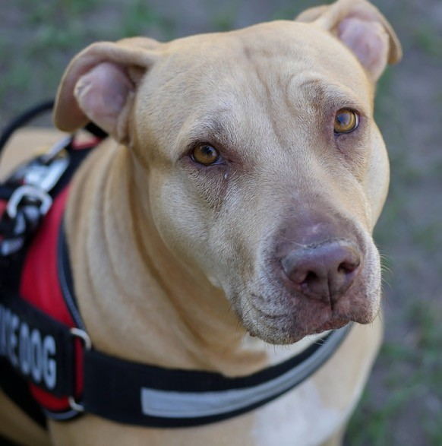
PERSONS WITH DISABILITIES
Reasonable accommodations that do not cause undue hardship must be provided. Here are a few examples:
Allow service animals (required).
Modifying existing facilities to make them accessible or usable for individuals with disabilities.
Providing qualified readers or interpreters.
Providing spaces for sitting.
Reminding beneficiaries that an alternate can pick up on their behalf.
Provide alternate arrangements for service.
Notes:
Always have assistance available for people with disabilities
Provide alternative arrangements for service
Sign language interpreters may be needed: Providing American Sign Language (ASL) interpreters for persons with hearing disabilities may be necessary to be able to adequately communicate with these applicants and participants.
Service animals must be allowed in facilities
2 Questions allowed: Is the animal a service animal required because of a disability? What work or task has the dog been trained to perform?

Slide 24


CIVIL RIGHTS COMPLAINTS
Verbal, written or anonymous.
Civil rights complaint is based on one or more of the protected classes.
Can be made to any person at any level.
Have specific process and procedures for your agency, as well as a log for documenting complaints.
•
Notes:
Can be verbal or written
Must be discrimination based on one or more of the 6 protected classes
Can be made to any volunteer or staff member at the sub-distributor/agency, the CDA/food ban, the Florida Department of Agriculture and Consumer Services or USDA
Agencies should have a specific complaint process and procedure

Slide 25

PROGRAM COMPLAINTS
Program complaints are still very important.
Have a different complaint process for handling these i.e., take down information, try to resolve, contact FDACS.
Examples of program complaints:
Not one of the six protected classes.
Food safety/quality issues.
Customer service, such as standing in a long line to receive food.
•
Notes:
Make sure to recognize the difference between a program complaint and a civil rights complaint.
PROGRAM complaints are not civil rights complaints, although equally important, and are NOT based on one of the 6 protected classes. You should have a different complaint process for handling these.
Examples of program complaints:
Classes NOT protected by the TEFAP program
Food Safety/Quality
Customer Service such as standing in a long line to receive the foods

Slide 26
HANDLING A CIVIL RIGHTS COMPLAINT
Handling a Civil Rights Complaint requires careful attention to detail.
Listen to the person making the complaint.
Practice good customer service.
Write it down using an established form.
Immediately move complaint up to person in charge.

Slide 27

PROCESSING A DISCRIMINATION COMPLAINT
Step 1. Supply client with USDA complaint form, your own form or take down all information. (180 days from alleged discrimination).
Step 2. Complaint is filed directly by client or sent to FDACS by agency (immediately).
Step 3. FDACS notifies USDA (3 working days).
Step 4. Investigation/resolution
(90 days from recipient of complaint).

Slide 28
Question time!
Can you identify which would be civil rights complaints and which would be program complaints?

Slide 29
1. An elderly client comes to pick up TEFAP foods. A volunteer tells him that he should go to a CSFP distribution site instead because he is over the age of 60.
2. A TEFAP distribution site is at a church, and clients must sit through a religious service before receiving food.
Notes:
While it is okay to refer a client to other nutrition programs, you cannot turn someone away due to their age. He could file a civil rights complaint.
Religion is not a protected class in TEFAP and would be a program complaint.

Slide 30
COMPLIANCE REVIEWS
Compliance reviews examine activities of State agencies, Subrecipients and Local Agencies to determine Civil Rights compliance.
Three types:
•
•
•
Pre-award compliance review.
Routine (Post-Award) compliance review. Special compliance review.

Slide 31
PRE-AWARD COMPLIANCE REVIEW
•
Occurs before you receive any food (or financial assistance, if applicable).
Happens at all levels.
•
•
Complete Civil Rights Pre-award Nondiscrimination Form
Notes:
Pre-award compliance reviews for Local Distributing Agencies are conducted by their Contracted Distributing Agency
Ensures the agency is ready to comply with Civil Rights regulations before distributing food

Slide 32
ROUTINE COMPLIANCE REVIEW
•
•
•
Scheduled.
Part of regular program review.
Looks for non-discrimination statement on printed materials, And Justice for All poster, reasonable accommodations for people with disabilities, etc.

Slide 33

SPECIAL COMPLIANCE REVIEWS
•
•
•
•
•
Conducted by USDA.
Follow up on previous findings. Investigate reports of noncompliance. Pattern for complaints of discrimination. May be scheduled or unscheduled.

Slide 34

RESOLUTION OF NONCOMPLIANCE
Noncompliance- A factual finding that any civil rights requirement is not being adhered to by a Subrecipient, Subdistributor or a Local Agency.
You will receive written notice indicating:
Areas of noncompliance.
Action required to correct the situation.

Slide 35

CUSTOMER SERVICE
•
Equal treatment and service for all clients.
•
Make people feel welcomed.
•
Communicate.
•
No special favors.
Notes:
Make sure that the clients receive equal treatment and service. “Equal” does not mean “Identical”. For example, one participant can receive corn while another receives green beans.
Make people feel welcomed - Treat everyone with dignity and respect and make people feel welcomed. Be patient and polite.
Communicate – It is important to communicate the clients’ rights as well as the process for picking up food or receiving meals. Respond to any questions in a non-threatening manner.
No special favors - Do not do special favors for anyone that you are not prepared to provide for everyone. Disabilities and Language needs are not considered “special favors” since they are required.

Slide 36
CONFLICT RESOLUTION
Treat others the way you want to be treated.
•
•
Post your agency’s policy for unacceptable behavior and conflicts. When conflict arises:
o o o o o o
Stay calm. Don’t interrupt.
Listen, be understanding and do not be judgmental. Identify the problem and possible solutions.
Follow up with the client.
Get help if you feel threatened or uncomfortable.
Notes:
Have a written and posted policy for dealing with unacceptable behavior and conflicts.
When a situation arises:
Try to remain calm. Do not interrupt the client – give them the full opportunity to explain the situation.
Listen to concerns and questions. Be empathetic and understanding. Do not be judgmental.
Identify the problem and determine possible solutions. Personally follow up with the client to make sure the issue gets resolved.
If the client becomes threatening, violent or makes you feel uncomfortable, get help immediately.

Slide 37
Beneficiary Notice Requirements
Partnerships with Faith-Based and Neighborhood Organizations:
Per 7 CFR Part 16.4(c)(1), “All organizations that receive USDA Foods or administrative funds for CSFP and TEFAP must provide a written notice to all beneficiaries and prospective beneficiaries of certain protections in a manner and form prescribed by policy FD- 155.”
Notes:
This slide explains that any organization, including our partners, must follow the federal rule requiring us to inform all clients of their civil rights. This is why we use the "And Justice for All" poster and the nondiscrimination statement.

Slide 38
Beneficiary Protections: Written Notice (CSFP)
To notify future and prospective beneficiaries, organizations must supply individual written notice of beneficiary protections under 7 CFR Part 16 at the time of application for CSFP benefits.
Providing CSFP applicants with a separate handout at the time of application. OR
Incorporating the required notification as an attachment in their existing CSFP applications.
OR
Included in other materials that are provided to beneficiaries before the receipt of services.
•
•
Notes:
NOT APPLICABLE AT AFFB

Slide 39
Beneficiary Protections: Written Notice (TEFAP)
To notify current and future or prospective beneficiaries, organizations providing TEFAP services must supply written notice of beneficiary protections under 7 CFR Part 16 by choosing one or more of these three methods:
Post a written notice at service locations. The posted written notice must be visible to all TEFAP beneficiaries and prospective beneficiaries upon entrance into the distribution site.
OR
Provide flyers or handouts at each distribution
OR
Add the written notification to their TEFAP intake form.
•
•

Slide 40
Beneficiary Protections: Referral Requirements
For both CSFP and TEFAP, the written notice described MUST also inform all parties about how to obtain information from either FNS or the State agency about other federally funded service providers in their area.
•
Provision requirements went into effect on July 2, 2024.
•
Monitoring for compliance of these requirements will be conducted as part of your agency’s scheduled administrative review.
Notes:
In short, it's a rule that requires us to do more than just inform clients of their rights in our program. We also have to point them to other resources they might be able to get from other organizations in their community.

Slide 41


More Questions? Comments? Contact Us.
FOR MORE INFORMATION:
Erin EverGreen - Client Registration Manager
941.549.8143
EEverGreen@AllFaithsFoodBank.org
Ana Hernandez - Agency Relations Coordinator
941.379.6333 Ext 141
AHernandez@AllFaithsFoodBank.org
Darla Walters - Agency Relations Manager
941.914.7717
DWalters@AllFaithsFoodBank.org

