Slide 1

2026 Annual TEFAP/CSFP
Civil Rights Training
WELCOME
Florida Department of Agriculture and Consumer Services
This institution is an equal opportunity provider.

Slide 2


CIVIL RIGHTS TRAINING
FOR TEFAP & CSFP SUBRECIPIENTS
Presented by:
All Faiths Food Bank
8171 Blaikie Ct, Sarasota, FL 34240
www.allfaithsfoodbank.org
941.379.6333

Slide 3


Agenda
Collection and use of client data
Effective public notification systems
Requirements for language assistance
Reasonable accommodation to persons with disabilities
Complaint procedures
Compliance reviews
Resolution of non-compliance
Customer service
Conflict resolution

Slide 4


WHY CIVIL RIGHTS TRAINING?
Training is required so that individuals involved in all levels of administration of programs that receive Federal financial assistance understand Federal laws, regulations, instructions, policies and other guidance.
Subrecipients are responsible for training their sub distributors and local agencies, including paid or volunteer staff who interact with participants or who handle participants’ records, on an annual basis.
New employees must be trained before participating in TEFAP/CSFP activities.
Volunteers must receive training appropriate to their roles and responsibilities.

Slide 5

WHAT IS DISCRIMINATION?
The act of distinguishing one person or group of persons from others, either intentionally, by neglect or by the effect of actions or lack of actions based on their protected classes.

Slide 6

PROTECTED CLASSES
Protected classes for TEFAP/CSFP:
•Age
Color
Disability
National Origin
Race
•Sex
People are also protected from reprisal or retaliation for prior civil rights activity.
Notes:
TEFAP recipients are protected from being treated differently because of any of the following reasons – disability, national origin, age, race, color and sex. These are called the protected classes. If someone files a civil rights complaint, they are also protected from retaliation. Retaliation happens when they are treated differently because they filed a complaint.
Do you think this scenario could be discriminatory? A food pantry that distributes TEFAP foods is located on the second floor of a building that does not have an elevator. Is this discriminatory? Why or why not?
The answer is yes, it could be discriminatory against people with disabilities. The pantry should attempt to make their building handicap accessible. If that is not possible, some other options would be bringing distribution for USDA programs downstairs or providing home delivery service for people with disabilities.

Slide 7
Question time!
Name the missing protected class.
Age, Color, Race, Sex, Disability and ?
Notes:
The answer is National Origin. That means people cannot be treated unfairly based on their ethnicity or accent or because they appear to be of a certain ethnic background.

Slide 8
EXAMPLES OF TYPES OF DISCRIMINATION
Disparate treatment (Intentional) Example: Age
Disparate impact (Unintentional) Example: National Origin
Reprisal/Retaliation (Intentional)
Example: Civil Rights Complaint

Slide 9
NON-DISCRIMINATION STATEMENT
LONG VERSION
vs.
SHORT VERSION

Slide 10
NONDISCRIMINATION STATEMENT
LONG VERSION
In accordance with federal civil rights law and U.S. Department of Agriculture (USDA) civil rights regulations and policies, this institution is prohibited from discriminating on the basis of race, color, national origin, sex, disability, age, or reprisal or retaliation for prior civil rights activity.
Program information may be made available in languages other than English. Persons with disabilities who require alternative means of communication to obtain program information (e.g., Braille, large print, audiotape, American Sign Language), should contact the responsible state or local agency that administers the program or USDA’s TARGET Center at (202) 720-2600 (voice and TTY) or contact USDA through the Federal Relay Service at (800) 877-8339.
To file a program discrimination complaint, a Complainant should complete a Form AD-3027, USDA Program Discrimination Complaint Form which can be obtained online at Program Discrimination Complaint Form English [ 409.6 kB] , Program Discrimination Complaint Form Spanish [389.3 kB] and, Program Discrimination Complaint Form Haitian Creol [185.2 kB] e , from any USDA office, by calling (866) 632-9992, or by writing a letter addressed to USDA. The letter must contain the complainant’s name,
address, telephone number, and a written description of the alleged discriminatory action in sufficient detail to inform the Assistant Secretary for Civil Rights (ASCR) about the nature and date of an alleged civil rights violation. The completed AD-3027 form or letter must be submitted to USDA by:
1.mail:
U.S. Department of Agriculture
Office of the Assistant Secretary for Civil Rights 1400 Independence Avenue, SW
Washington, D.C. 20250-9410; or
2.fax:
(833) 256-1665 or (202) 690-7442; or
3.email: program.intake@usda.gov
This institution is an equal opportunity provider.

Slide 11
NONDISCRIMINATION STATEMENT
SHORT VERSION
“This institution is an equal opportunity provider.”
May be used in special circumstances only
•May not be used in place of long statement on recipients’ rights documents
Must be in font size no smaller than the font size used in rest of publication

Slide 12
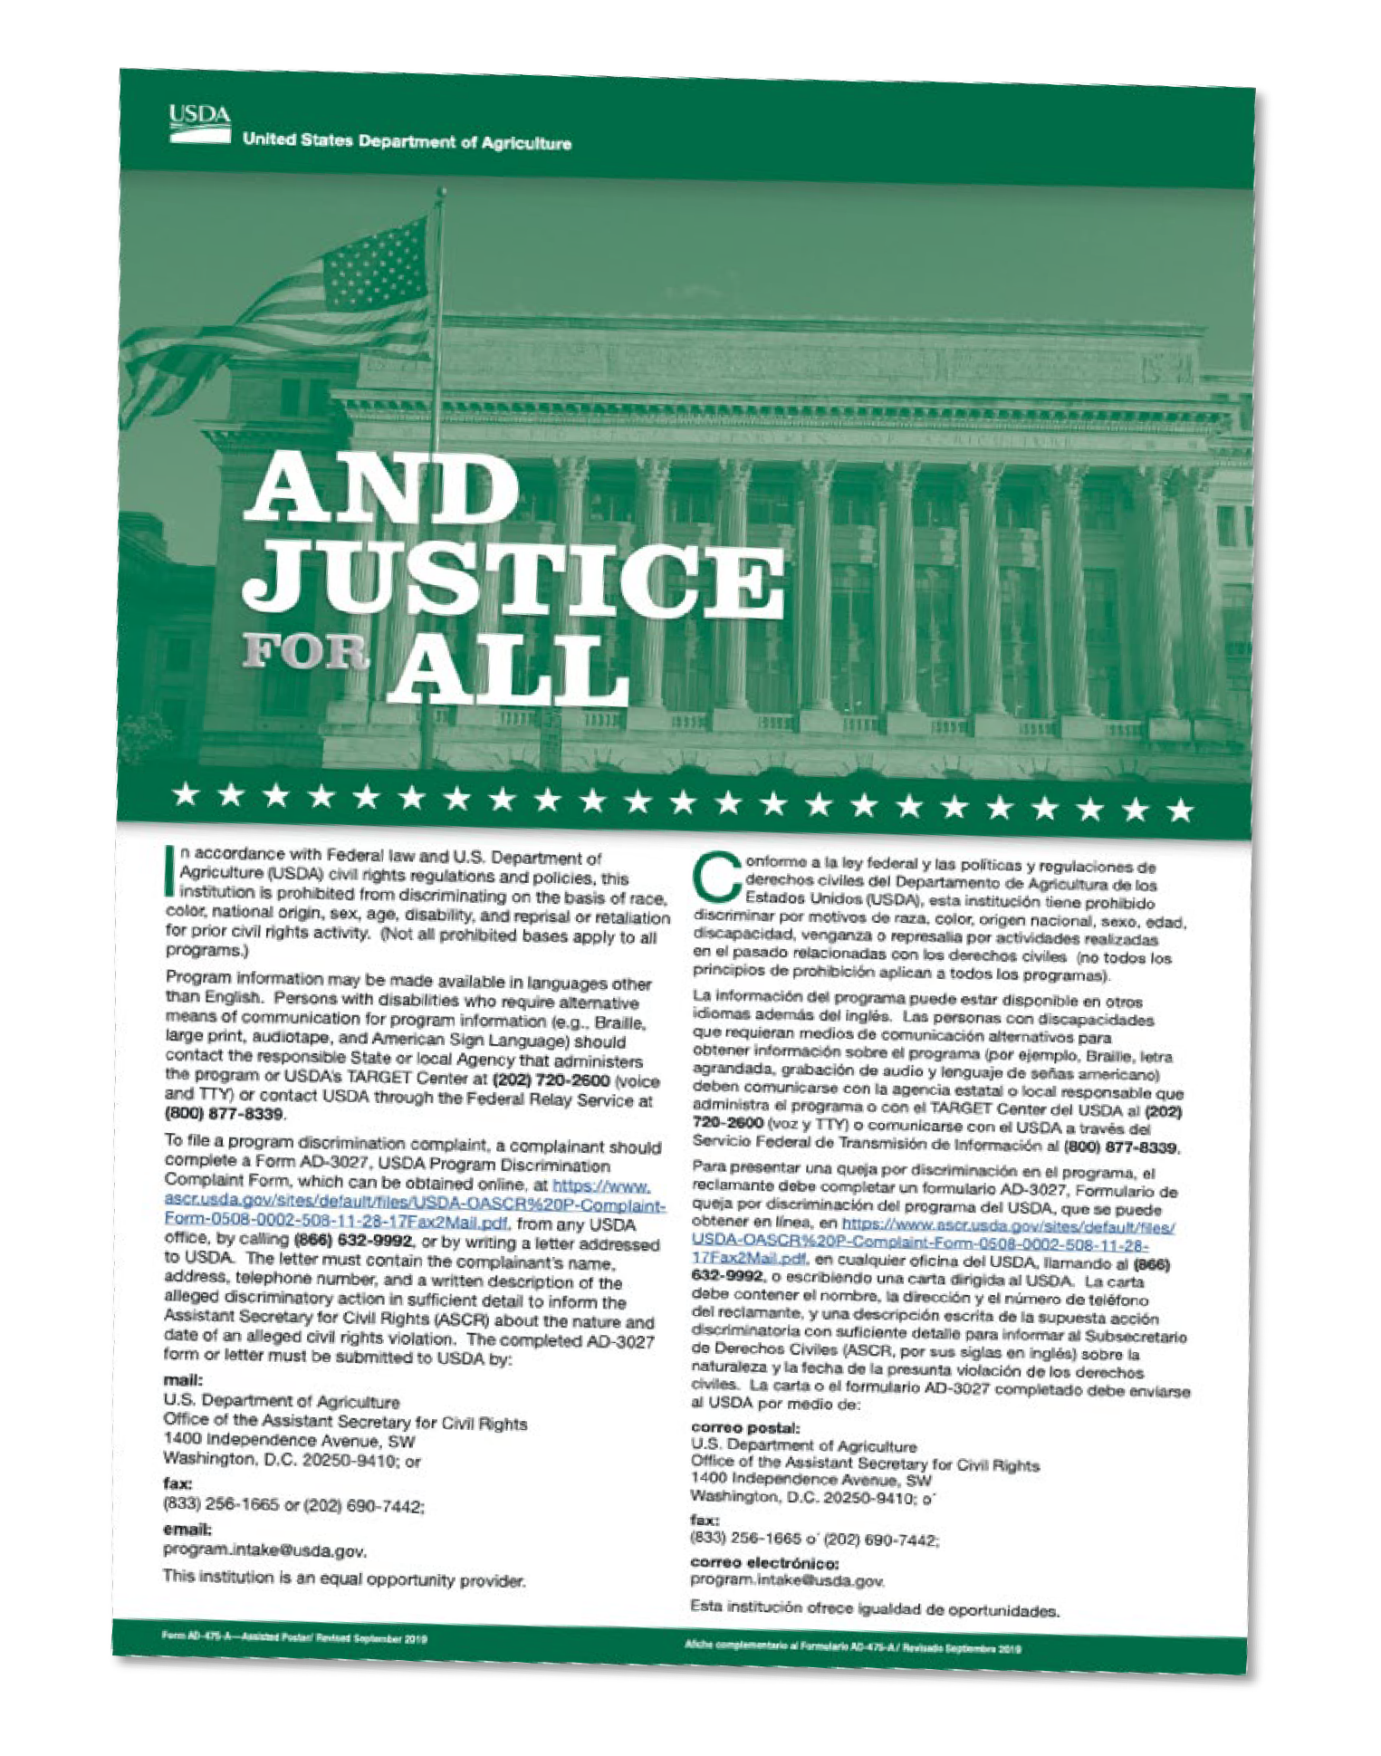
“AND JUSTICE FOR ALL”
Poster
This is the most current poster
Post in a prominent location where recipients and applicants can see it (This includes mobile distributions)
This poster serves as a trademark indicating the site provides USDA program without discrimination

Slide 13



Slide 14

DATA COLLECTION AND REPORTING
•TEFAP is exempt from data collection requirements
•The collection and reporting of recipients ethnicity and race for CSFP is required

Slide 15


ETHNIC AND RACIAL DATA COLLECTION AND REPORTING
PURPOSE:
To determine how effectively Food and Nutrition Services (FNS) programs are reaching potentially eligible persons and participants, outreach and selection of locations for administrative reviews.
Collect and report annually for the month of April via FANS
Due by May 31^{st.}
Collect at the point of application/retain at the service delivery area.
Limit data access to authorized personnel.
Florida Department of Agriculture and Consumer Services
Division of Food, Nutrition and Wellness

Slide 16
ETHNIC AND RACIAL DATA COLLECTION
TWO-QUESTION FORMAT
Ethnicity (Select one): Hispanic or Latino – A person of Cuban, Mexican, Puerto Rican, South or Central American, or other Spanish culture or origin, regardless of race. Not Hispanic or Latino |  | Race (Select one or more): American Indian or Alaskan Native Asian Black or African American Native Hawaiian or Other Pacific Islander •White
Ethnicity and race are two separate categories as federally recognized by the Office of Management and Budget.

Slide 17
PUBLIC NOTIFICATION/OUTREACH METHODS
Reaching Prospective Clients
PRESS RELEASES – newspaper, TV station, online
ADVERTISEMENTS – newspaper, social media, TV
SIGNS – outside your facility, post serving times
FLYERS – clinics, public assistance offices, schools, libraries, etc
Provide information in different formats/languages.

Slide 18
QUESTIONS?

Slide 19
What would you do?
There is small Haitian community in your service area that may benefit from TEFAP. Your organization wants to create a flyer in Creole to distribute.
You have paid a translator and created and printed the flyer, but realized you forgot the non-discrimination statement.
Is it still okay to distribute the flyer?
Notes:
The answer is no. It is never okay to distribute program information without the non-discrimination statement.

Slide 20

Requirements for Language Assistance
LIMITED ENGLISH PROFICIENCY (LEP)
LEP are those who do not speak English as their primary language and who have a limited ability to read, speak, write, or understand English because of their national origin
Responsibility to take reasonable steps to ensure “meaningful access” to programs and activities
Meaningful Access is to provide reasonable, timely, appropriate, and competent language services at no cost to the LEP person
Failure could be discrimination on the basis of national origin
Notes:
Agencies must take into consideration individuals who do not speak English as their primary language and who have a limited ability to read, speak, write, or understand English. If someone came to your agency and they only spoke Creole, would you be prepared to offer them service? If not, there is a potential for a “National Origin” civil rights complaint.
All agencies participating in TEFAP have the responsibility to take reasonable steps to ensure meaningful access to their programs and activities by persons with limited English proficiency (LEP).
Interpreters: Volunteers may be used as interpreters and must maintain participant confidentiality. Children should not be used as interpreters.

Slide 21


FACTORS FOR PROVIDING LANGUAGE ASSISTANCE
Level of service provided is based on the following factors. Shortage of resources does not eliminate requirement except for cases of extreme hardship.
Number or proportion
Frequency
Importance
Resources

Slide 22

PERSONS WITH DISABILITIES
Americans with Disabilities Act
Section 504 of the Rehabilitation Act of 1973
7 CFR Part 15b
Notes:
Disability Rights Laws We Follow
ADA: Requires equal access for people with disabilities; we provide reasonable accommodations (ramps, effective communication)
Section 504: Applies to us because we receive federal funds; prohibits disability discrimination in our programs
7 CFR Part 15b: The detailed "rulebook" for how to comply with Section 504
More Details:
Americans with Disabilities Act (ADA)
The ADA is a broad law that prohibits discrimination against people with disabilities in all areas of public life, including jobs, schools, transportation, and all public and private places open to the general public. For a food bank, it means you must make reasonable efforts to accommodate a person's disability to allow them to access services. For example, ensuring ramps are available for people who use wheelchairs or providing a sign language interpreter for a deaf person during a food distribution event if requested.
Section 504 of the Rehabilitation Act of 1973
Section 504 is an earlier law that prohibits discrimination on the basis of disability in programs that receive federal financial assistance. Since food banks often receive federal funding for programs like TEFAP and CSFP, they fall under this law. It requires that these programs be accessible to people with disabilities. While similar to the ADA, it applies specifically to organizations receiving federal funds, making it highly relevant for food assistance programs.
7 CFR Part 15b
This is the specific federal regulation that outlines the rules for compliance with Section 504 of the Rehabilitation Act. It provides detailed instructions and procedures for how agencies and organizations receiving federal assistance must ensure their programs are nondiscriminatory toward people with disabilities. Think of it as the detailed rulebook that tells a food bank exactly what actions it must take to be in compliance with Section 504.

Slide 23

PERSONS WITH DISABILITIES
DISABLED PERSON
A person who has a physical or mental impairment which substantially limits one or more major life activities, has a record of such an impairment, or is regarded as having such an impairment.
Major life activity means functions such as caring for one’s self, performing manual tasks, walking, seeing, hearing, speaking, breathing, learning and working.
Notes:
Always have assistance available for people with disabilities
Provide alternative arrangements for service
Sign language interpreters may be needed: Providing American Sign Language (ASL) interpreters for persons with hearing disabilities may be necessary to be able to adequately communicate with these applicants and participants.
Service animals must be allowed in facilities
2 Questions allowed: Is the animal a service animal required because of a disability? What work or task has the dog been trained to perform?

Slide 24

REASONABLE ACCOMMODATIONS TO PERSONS WITH DISABILITIES
Reasonable accommodations that do not cause undue hardship must be provided. Here are a few examples:
Allow service animals (required)
Modifying existing facilities to make them accessible or usable for individuals with disabilities
Providing qualified readers or interpreters
Providing spaces for sitting
Reminding beneficiaries that an alternate can pick up on their behalf
Provide alternate arrangements for service

Slide 25
COMPLAINT PROCEDURES
CIVIL RIGHTS COMPLAINT
Based on one or more of the protected classes
PROGRAM COMPLAINT
Not based on one of the protected classes
Example:
  Quality of food
  Quantity of food
  Customer service
Have a different process to handling and resolving
•
Verbal, written or anonymous
Can be made to any person at any level
Processes and procedures as well as a log for documenting complaints
Notes:
Make sure to recognize the difference between a program complaint and a civil rights complaint.
PROGRAM complaints are not civil rights complaints, although equally important, and are NOT based on one of the 6 protected classes. You should have a different complaint process for handling these.
Examples of program complaints:
Classes NOT protected by the TEFAP program
Food Safety/Quality
Customer Service such as standing in a long line to receive the foods
Can be verbal or written
Must be discrimination based on one or more of the 6 protected classes
Can be made to any volunteer or staff member at the sub-distributor/agency, the CDA/food ban, the Florida Department of Agriculture and Consumer Services or USDA
Agencies should have a specific complaint process and procedure

Slide 26
HANDLING A CIVIL RIGHTS COMPLAINT
Handling a Civil Rights Complaint requires careful attention to detail.
Listen to the person making the complaint
Practice good customer service
Write it down using an established form
Immediately escalate the complaint to management

Slide 27


PROCESSING A DISCRIMINATION COMPLAINT
Step 1. Supply client with USDA complaint form, your own form or take down all information (180 days from alleged discrimination)
Step 2. Complaint is filed directly by client or sent to FDACS by agency (immediately)
Step 3. FDACS notifies USDA (3 working days)
Step 4. Investigation/resolution
(90 days from recipient of complaint)

Slide 28
COMPLIANCE REVIEWS
Compliance Reviews examine activities of State agencies, Subrecipients and Local Agencies to determine Civil Rights compliance.
Three types:
Pre-award compliance review
Routine (Post-award) compliance review
Special compliance review

Slide 29
PRE-AWARD COMPLIANCE REVIEW
The subrecipient must ensure that the new local or subdistributing agencies are ready to comply with civil rights regulations before distributing food/funds, by conducting a desk or onsite compliance review
Happens at all levels
Complete Civil Rights Pre-Award Nondiscrimination Form

Slide 30
ROUTINE COMPLIANCE REVIEW
Scheduled
Part of a regular compliance review by FDACS
Looks for non-discrimination statement on printed materials, And Justice for All poster, reasonable accommodations for people with disabilities, etc.

Slide 31

SPECIAL COMPLIANCE REVIEWS
Conducted by USDA
Follow up on previous findings
Investigate reports of noncompliance
Pattern for complaints of discrimination
May be scheduled or unscheduled

Slide 32

RESOLUTION OF NONCOMPLIANCE
Noncompliance - A factual finding that any civil rights requirement is not being adhered to by a Subrecipient, Subdistributor or a Local Agency.
You will receive written notice indicating:
Areas of noncompliance
Action required to correct the situation

Slide 33
Question time!
Can you identify which would be civil rights complaints and which would be program complaints?

Slide 34
1. An elderly client comes to pick up TEFAP foods. A volunteer tells him that he should go to a CSFP distribution site instead because he is over the age of 60.
2. A TEFAP distribution site is at a church, and clients must sit through a religious service before receiving food.
Notes:
While it is okay to refer a client to other nutrition programs, you cannot turn someone away due to their age. He could file a civil rights complaint.
Religion is not a protected class in TEFAP and would be a program complaint.

Slide 35

CUSTOMER SERVICE
Equal treatment and service for all clients
Welcoming environment
Communicate the process
No special favors
Notes:
Make sure that the clients receive equal treatment and service. “Equal” does not mean “Identical”. For example, one participant can receive corn while another receives green beans.
Make people feel welcomed - Treat everyone with dignity and respect and make people feel welcomed. Be patient and polite.
Communicate – It is important to communicate the clients’ rights as well as the process for picking up food or receiving meals. Respond to any questions in a non-threatening manner.
No special favors - Do not do special favors for anyone that you are not prepared to provide for everyone. Disabilities and Language needs are not considered “special favors” since they are required.

Slide 36
CONFLICT RESOLUTION
Post your agency’s policy for unacceptable behavior and conflicts.
Treat others the way you want to be treated. When conflict arises:
Stay calm
Don’t interrupt
Listen, be understanding and do not be judgmental
Identify the problem and possible solutions
Follow up with the client
Get help if you feel threatened or uncomfortable

Slide 37


Written Notice of Beneficiary Protections
Partnerships with Faith-Based and Neighborhood Organizations:
Per 7 CFR Part 16.4(c)(1),
“All organizations that receive USDA Foods or administrative funds for CSFP and TEFAP must provide a written notice to all beneficiaries and prospective beneficiaries of certain protections in a manner and form prescribed by policy FD-
155.”

Slide 38
Beneficiary Protections: Written Notice (CSFP)
To notify future and prospective beneficiaries, organizations must supply individual written notice of beneficiary protections under 7 CFR Part 16 at the time of application for CSFP benefits.
Providing CSFP applicants with a separate handout at the time of application OR
Incorporating the required notification as an attachment in their existing CSFP applications
OR
Included in other materials that are provided to beneficiaries before the receipt of services

Slide 39
Beneficiary Protections: Written Notice (TEFAP)
To notify current and future or prospective beneficiaries, organizations providing TEFAP services must supply written notice of beneficiary protections under 7 CFR Part 16 by choosing one or more of these three methods:
Post a written notice at service locations. The posted written notice must be visible to all TEFAP beneficiaries and prospective beneficiaries upon entrance into the distribution site.
OR
Provide flyers or handouts at each distribution
OR
Add the written notification to their TEFAP intake form

Slide 40
Beneficiary Protections: Referral Requirements
For both CSFP and TEFAP, the written notice described MUST also inform all parties about how to obtain information from FNS and/or FDACS about other federally funded service providers in their area
Monitoring for compliance of these requirements will be conducted as part of your agency’s scheduled administrative review
Notes:
In short, it's a rule that requires us to do more than just inform clients of their rights in our program. We also have to point them to other resources they might be able to get from other organizations in their community.

Slide 41

THANK YOU
FOR MORE INFORMATION
Erin EverGreen - Client Registration Manager
941.549.8143
EEverGreen@AllFaithsFoodBank.org
Ana Hernandez - Agency Relations Coordinator
941.379.6333 Ext 141
AHernandez@AllFaithsFoodBank.org
Darla Walters - Agency Relations Manager
941.914.7717
DWalters@AllFaithsFoodBank.org
Florida Department of Agriculture and Consumer Services
This institution is an equal opportunity provider.

